Slide 1
ENIGMA Integrative Analysis Update
2025/03/19

Slide 2

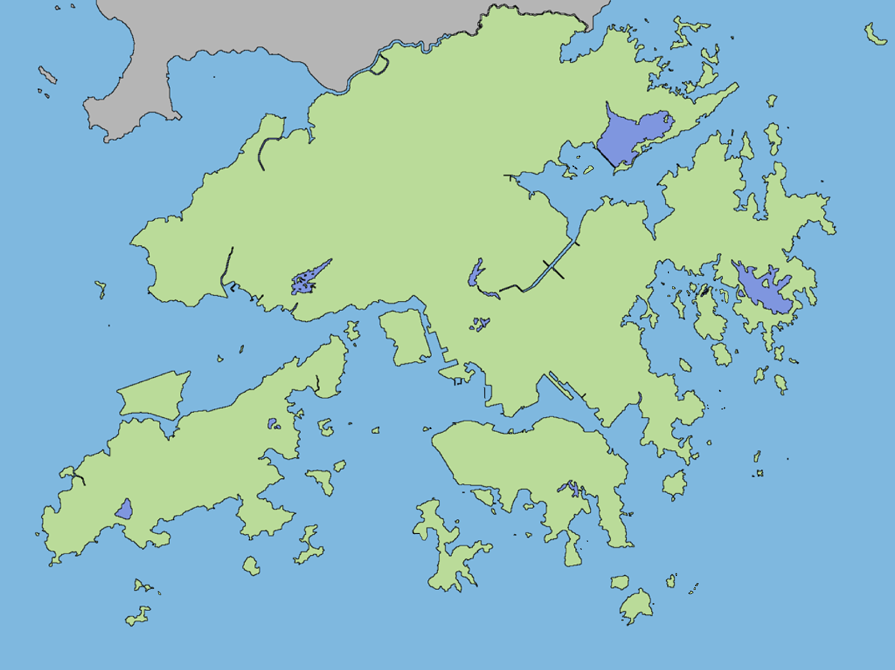
479 subjects from three regions
Kunming, Mainland China (MC)
(Asian, Rural)
Hong Kong (HK)
(Asian, Urban)
Subjects | Sample size (n)
Crohn’s disease | 240
Controls | 239
Australia (AUS)
(Caucasian, Urban)

Slide 3










Graphical Summary of ENIGMA Research Cohort
Species (n =605)
Species
Anthropometrics
Pathway
(n = 479)
Pathway (n = 479)
Diet
Metagenomic sequencing
Gene
Gene (n = 615)
Early life exposures
CD subjects
Controls
Biopsy 16s
rRNA sequencing
Medication
Australia
Hong Kong
Kunming
(n = 266)
Food additives
Questionnaires

Slide 4
Aims
To illuminate the signatures of microbiome, microbial genes and functional pathways in CD patients and controls cross populations
To uncover the clinical information, environmental factors and bacterial features that may correlated with disease activity in CD

Slide 5
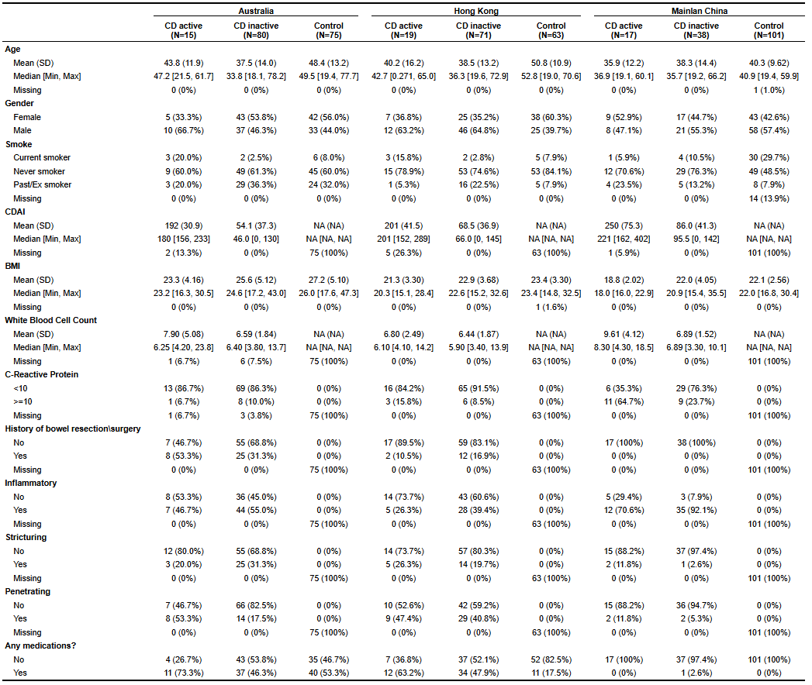
Subject characteristics
Location
L1 terminal ileum
L2 colonic
L3 ileocolonic

Slide 6
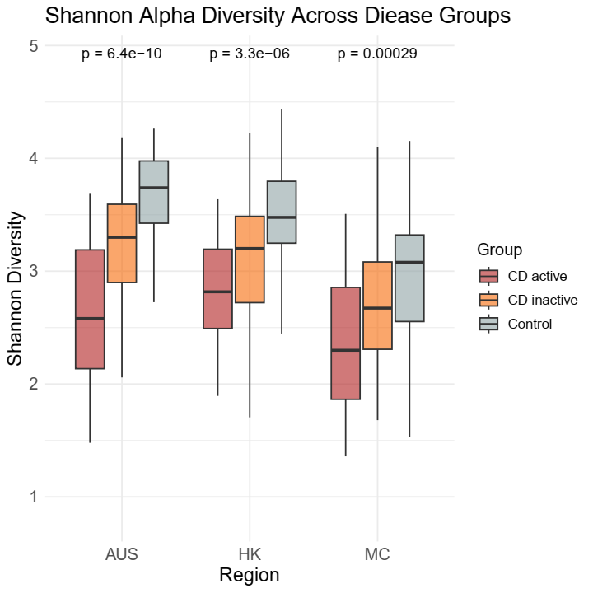
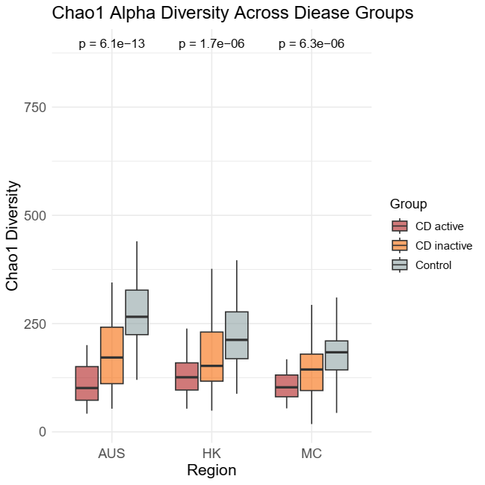
Gut Microbiome Diversity cross AUS, HK, and MC
Gut microbiome diversity was significantly lower in active CD patients compared with inactive CD patients and control.

Slide 7
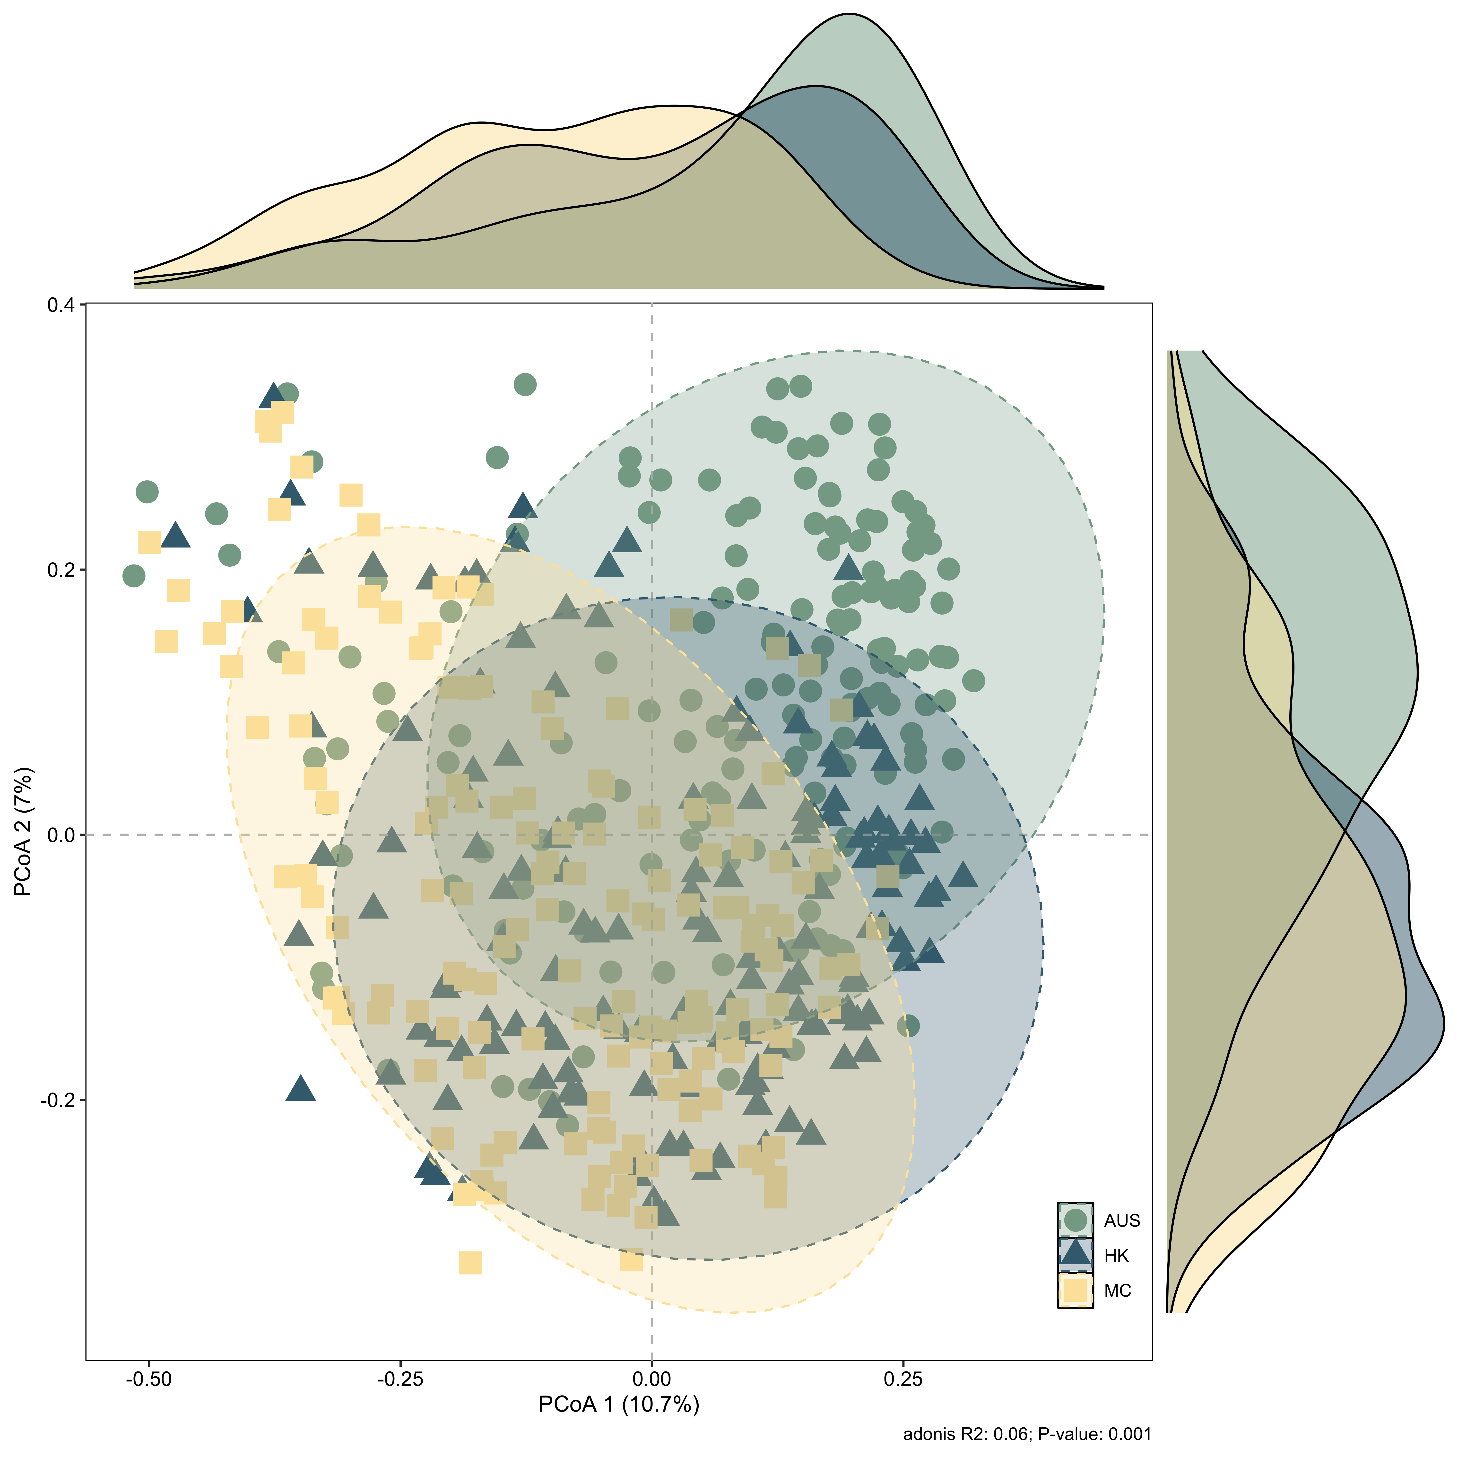
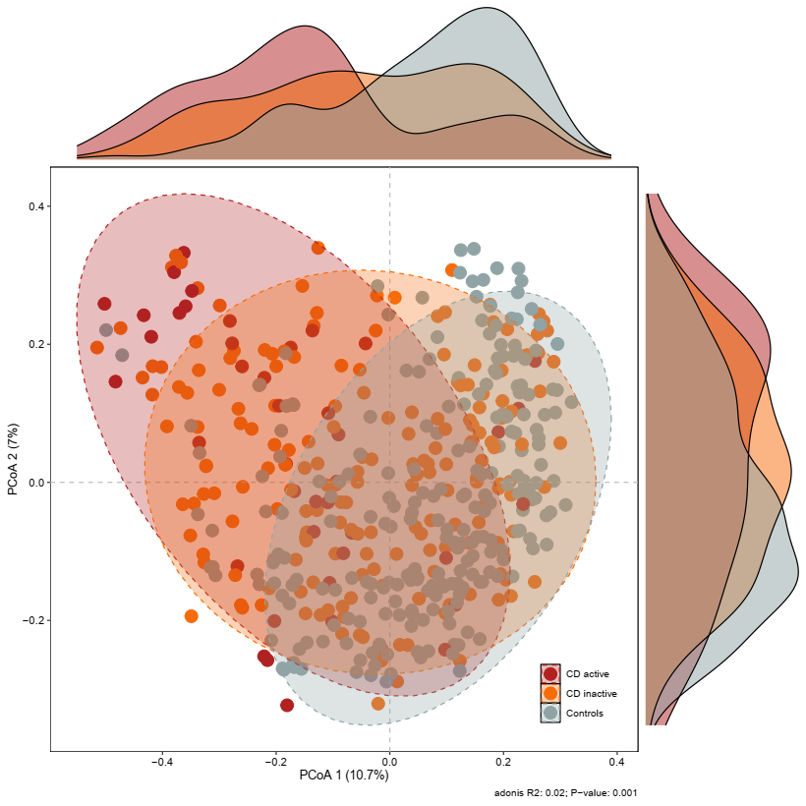
Gut Microbiome Composition
By region
Adonis R2: 0.06
P value: 0.001
By disease
Adonis R2: 0.02
P value: 0.001
The gut microbial composition varies significantly among different regions and disease status.
The differences in the gut microbiomes of patients with active CD are more pronounced compared to the control group.

Slide 8
Gut Microbiome Composition
According to the Bray-Curtis distance, the differences between patients with active CD and the control group were greater than those between patients with inactive CD and the control group.
Additionally, the differences among patients with active CD were larger, indicating that there may be greater heterogeneity in the microbial composition of active CD patients.

Slide 9
Microbiome Analysis Workflow
Relative Abundance of Bacterial Species
Venn Diagram
Venn Diagram
Data Filtering
Venn Diagram
Bar Plots
MaAsLin2
Venn Diagram
Heatmap
CD-enriched and CD-depleted Species
Notes:
MaAsLin2（Multivariate Association with Linear Models）是一种用于分析微生物组数据的统计工具，专门用于检测微生物组数据与其他元数据（如临床变量、环境因素等）之间的关联。它是MaAsLin的升级版，由Huttenhower Lab开发，广泛应用于微生物组学研究。

Slide 10
Venn Diagram for Bacterial Species
Differential species identified using MaAsLin2 (qvalue<0. 25)
All species

Slide 11
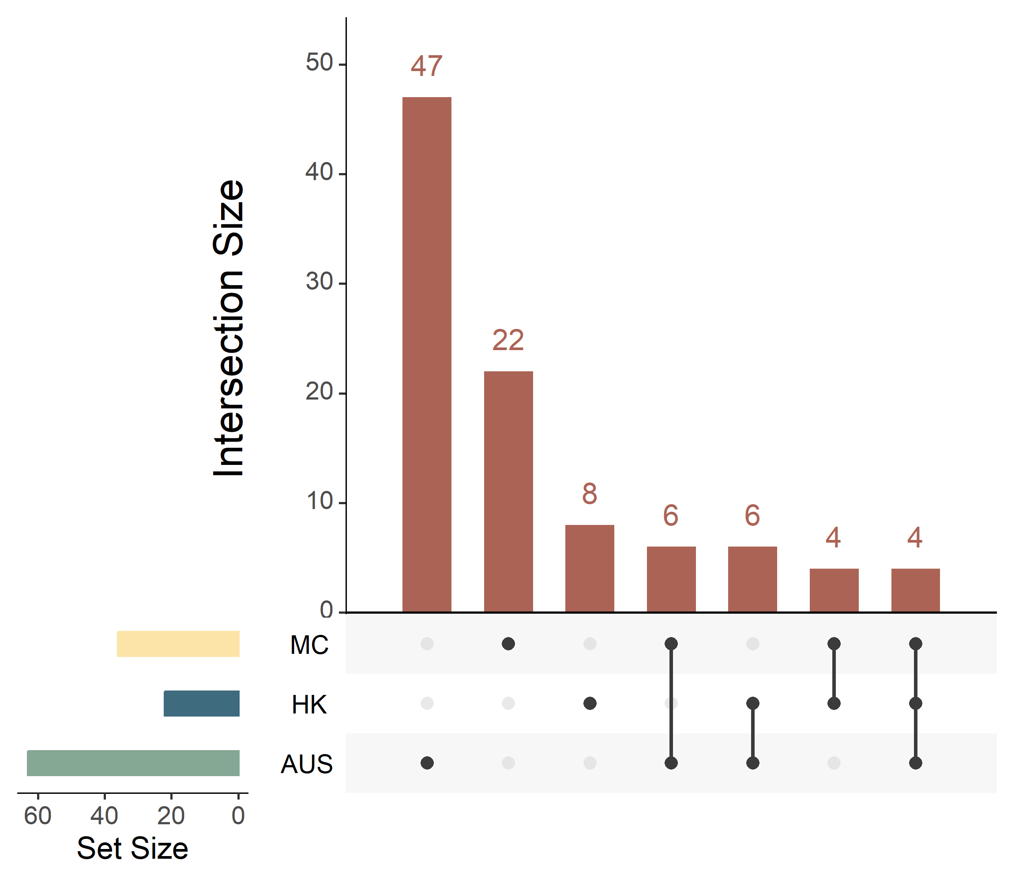
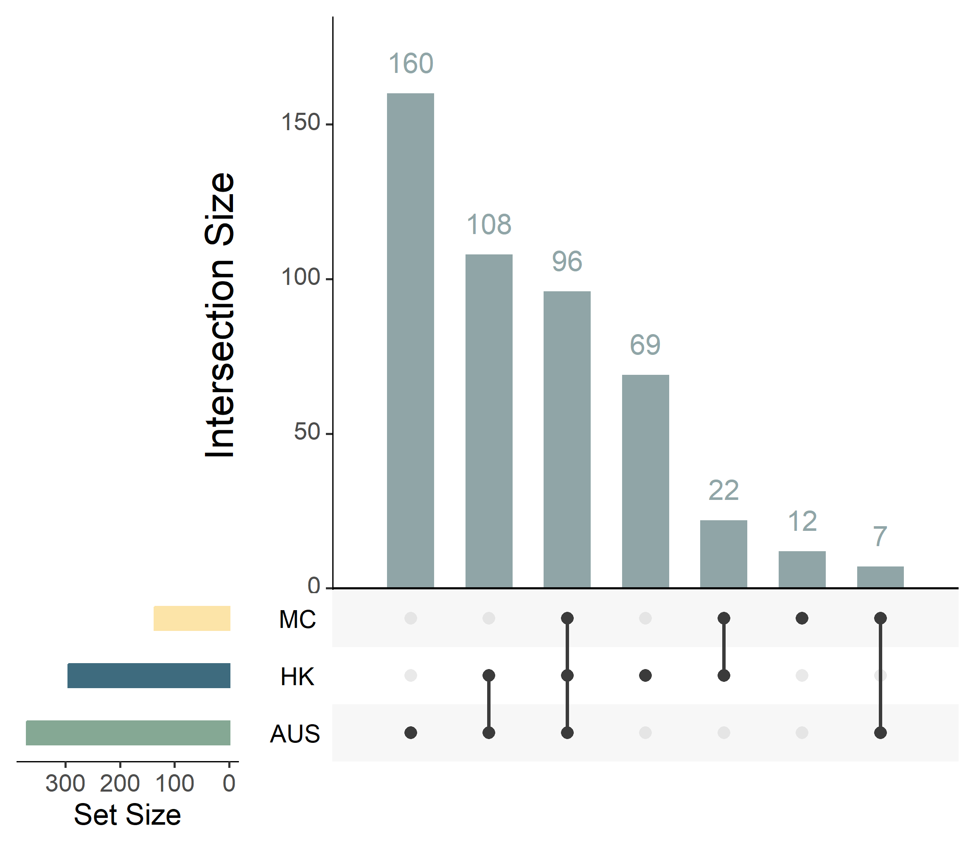
Comparison of CD-enriched and CD-depleted species among AUS, HK, and MC
CD-enriched bacteria
CD-depleted bacteria
36
137
22
295
63
371

Slide 12
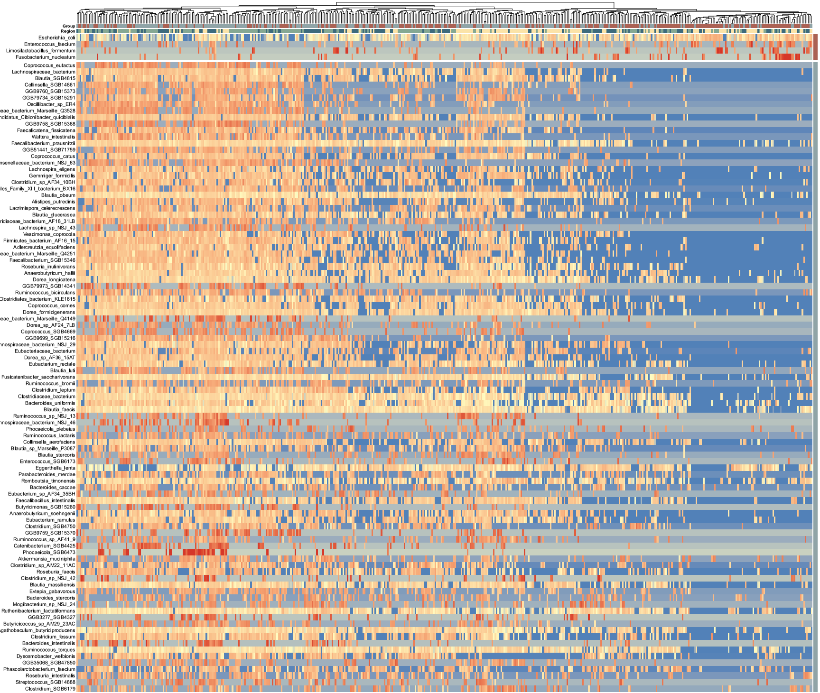
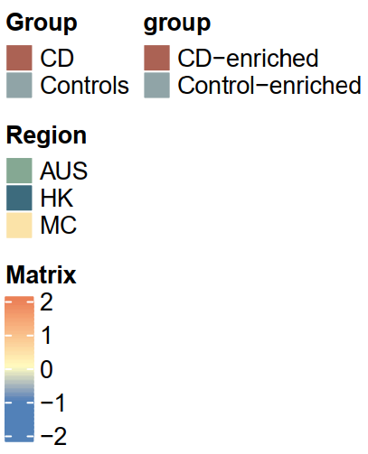
CD-enriched species
(n=4)
Escherichia coli
Enterococcus faecium
Limosilactobacillus fermentum
Fusobacterium nucleatum
CD-depleted species
(n=97)
Scaled(Log10(Matrix))

Slide 13
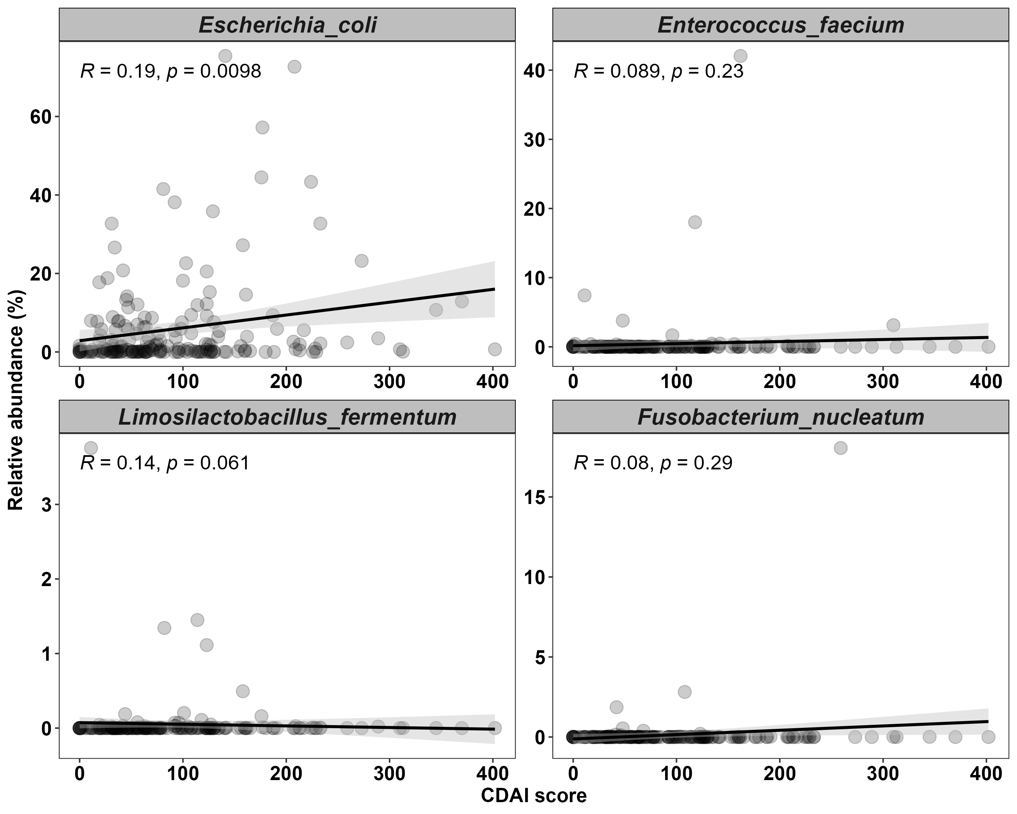
Three Species Correlated with Disease Activity

Slide 14
Functional Pathways Analysis Workflow
Relative Abundance of Pathways
Venn Diagram
Venn Diagram
Data Filtering
Venn Diagram
Bar Plots
MaAsLin2
Venn Diagram
Heatmap
CD-enriched and CD-depleted Pathways

Slide 15
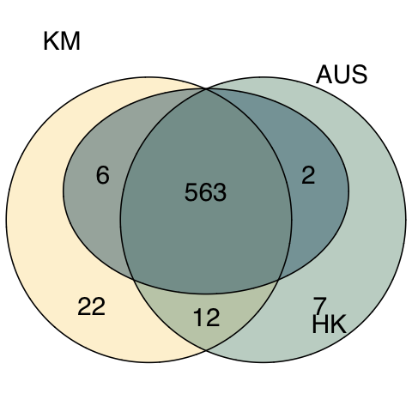
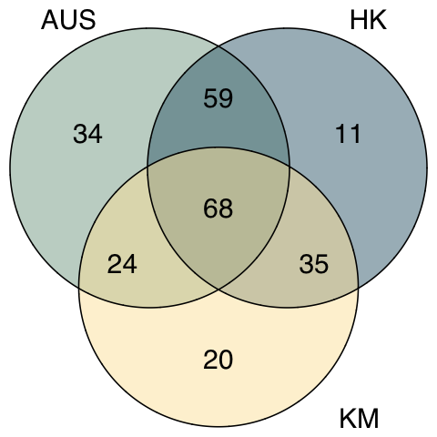
Venn Diagram for Pathways
Differential pathways identified using MaAsLin2 (p<=0.05)
All pathways
MC
MC

Slide 16
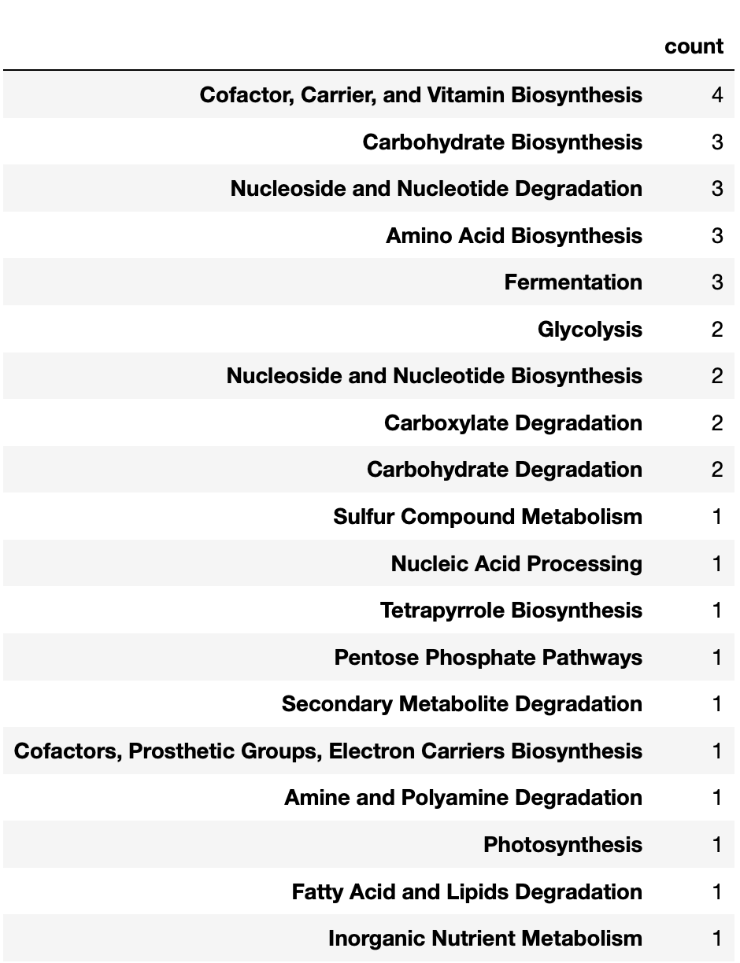
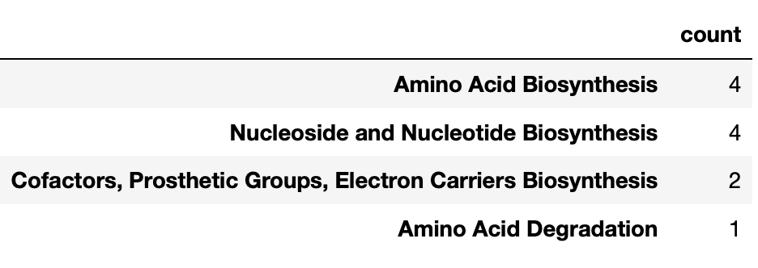
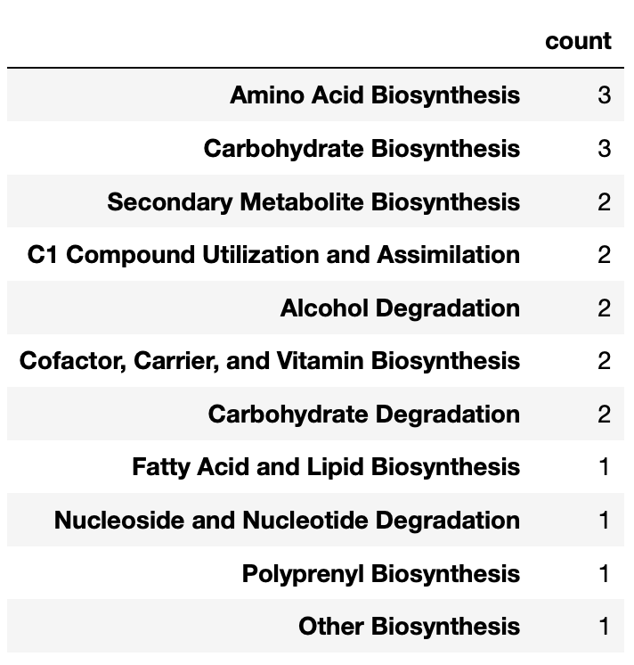
Functions from Unique Pathways in AUS, HK, and MC
MC
Differential pathways identified using MaAsLin2 (p<=0.05)
Notes:
Function 个数

Slide 17
CD-enriched and CD-depleted Pathways in AUS, HK, and MC
Most Frequent CD-enriched Functions:
Cofactor, Carrier, and Vitamin Biosynthesis
Fatty Acid and Lipid Biosynthesis
Amino Acid Biosynthesis
CD-enriched
CD-depleted
Most Frequent CD-depleted Functions:
Cofactor, Carrier, and Vitamin Biosynthesis
Cell Structure Biosynthesis
Amino Acid Biosynthesis
Coef

Slide 18
Bacterial Species contributing to CD-enriched and CD-depleted Pathways
CD-depleted
CD-enriched
Relative Abundance

Slide 19
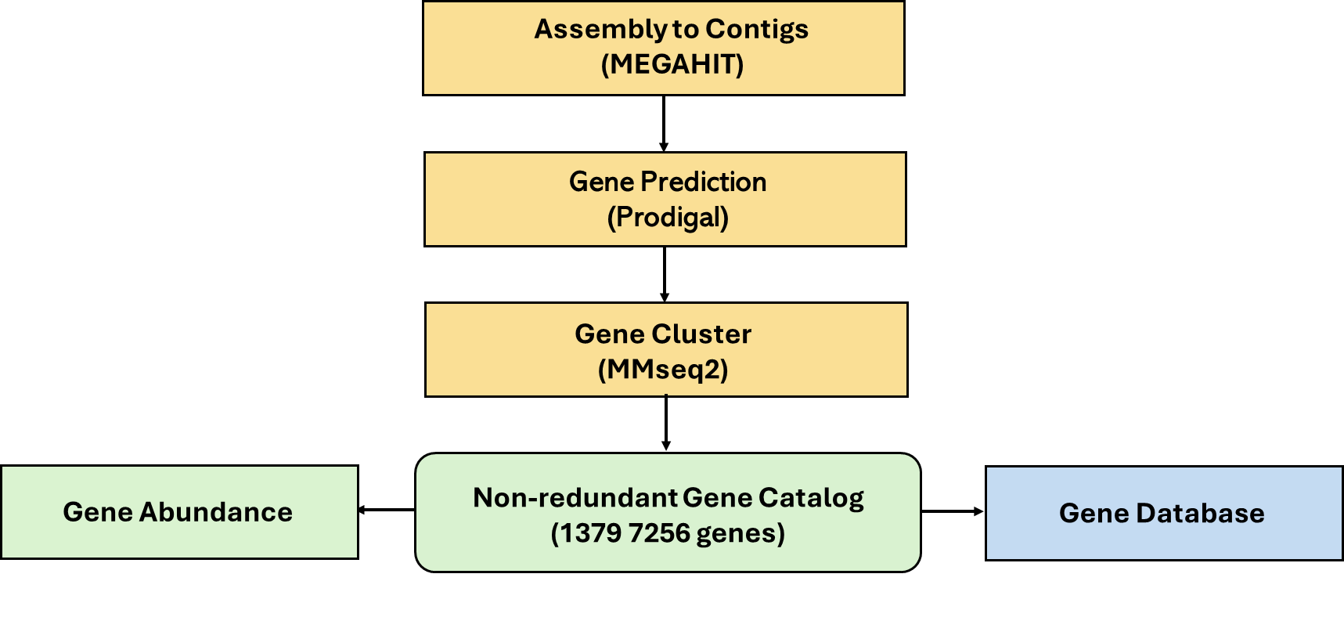
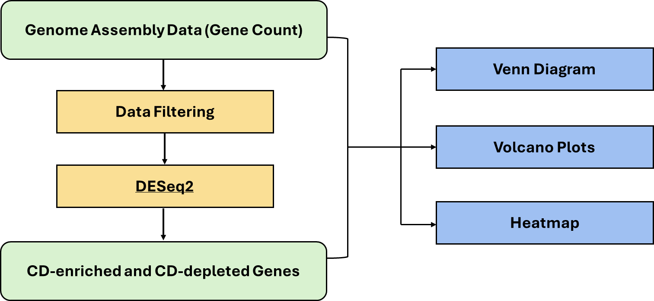
Microbial Gene Annotation Workflow

Slide 20
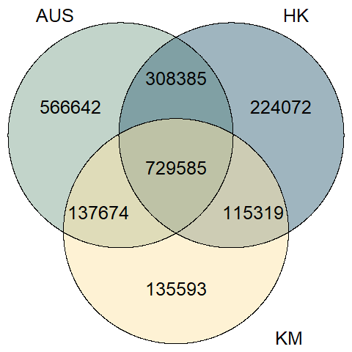
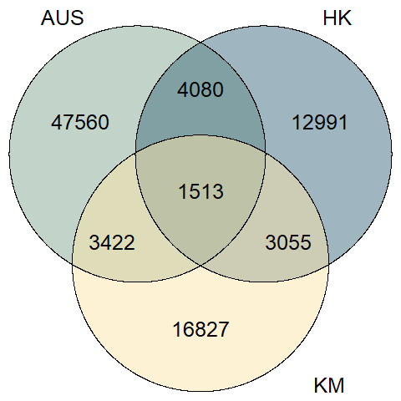
Venn Diagram for Microbial Genes
Differential genes identified using Deseq (p<=0.05)
All genes
MC
MC
Notes:
left side: based on raw gene count; right side: based on DESeq2 output

Slide 21
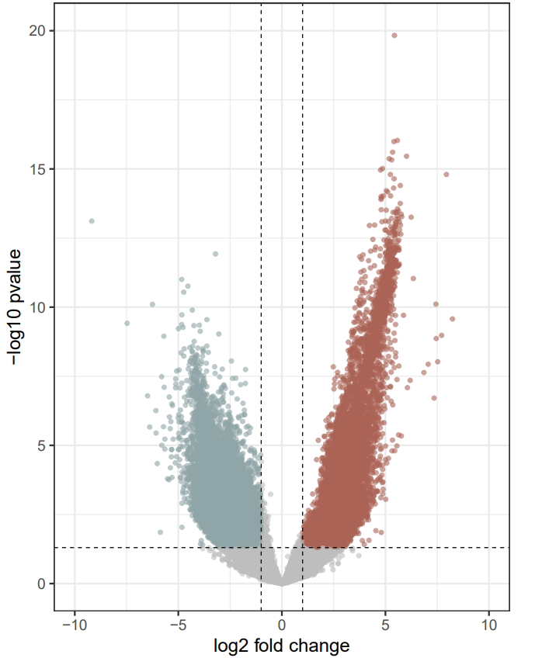
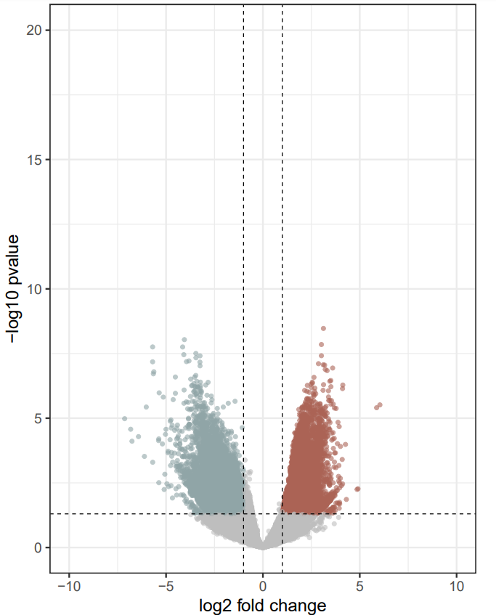
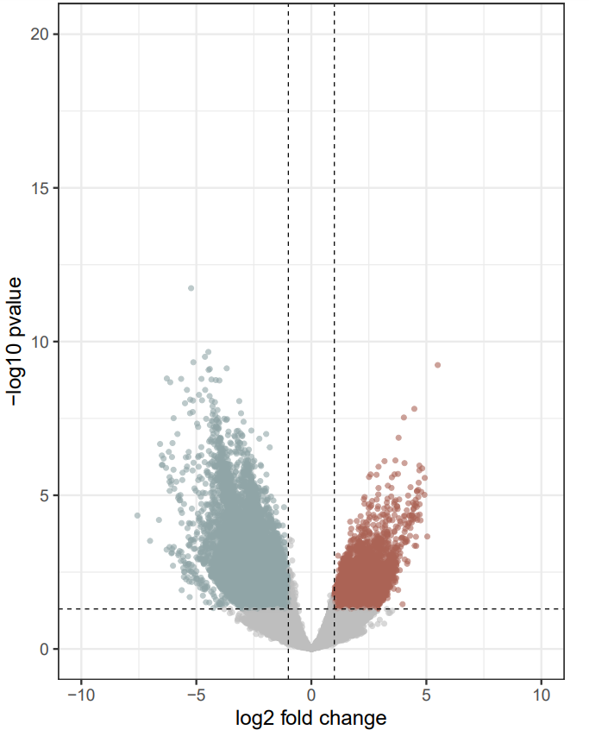
CD-enriched and CD-depleted Microbial Genes in AUS, HK, and MC
CD-depleted
CD-enriched
CD-depleted
CD-enriched
CD-depleted
CD-enriched
AUS
HK
MC
44223
10979
13834
7168
20565
3705
Cutoff for log2 FC is 1
Cutoff for p-value is 0.05
Cutoff for log2 FC is 1
Cutoff for p-value is 0.05
Cutoff for log2 FC is 1
Cutoff for p-value is 0.05

Slide 22
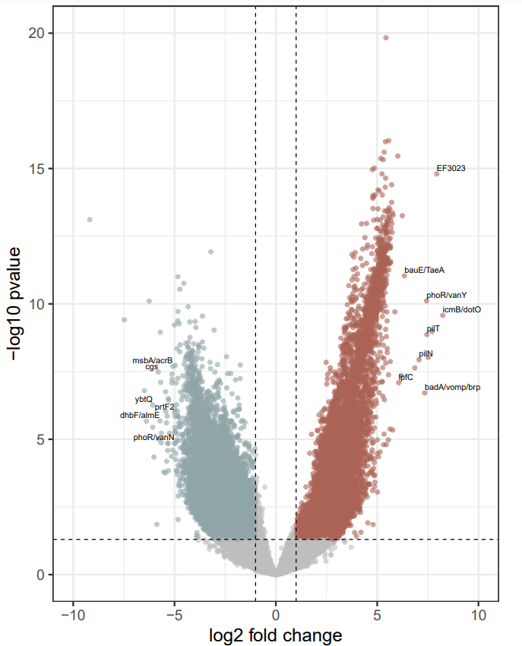
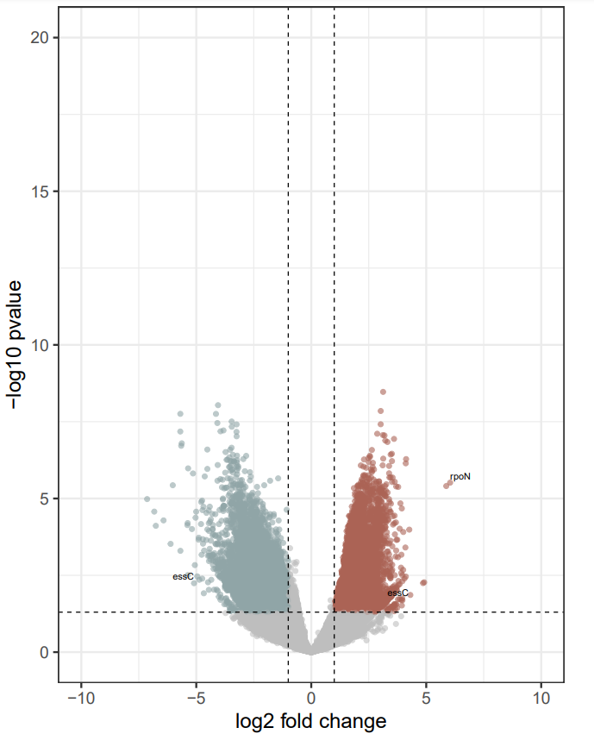
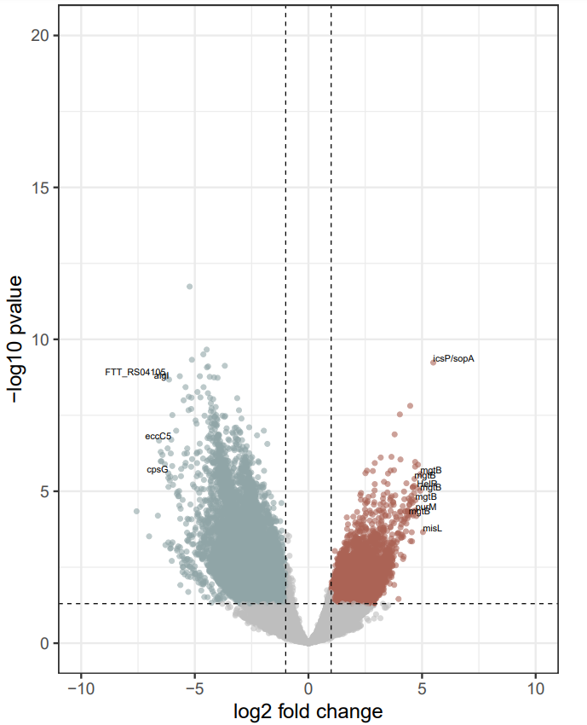
CD-enriched and CD-depleted Microbial Genes in AUS, HK, and MC
CD-depleted
CD-enriched
CD-depleted
CD-enriched
CD-depleted
CD-enriched
AUS
HK
MC
44223
10979
13834
7168
20565
3705
Cutoff for log2 FC is 1
Cutoff for p-value is 0.05
Cutoff for log2 FC is 1
Cutoff for p-value is 0.05
Cutoff for log2 FC is 1
Cutoff for p-value is 0.05
Notes:
Label those outliers

Slide 23
Microbial Gene Annotation Workflow
173
Virulence Factor Genes (VFGs)
1469
1134
Microbial genes consistently up- and down-regulated in CD patients cross AUS, HK, and MC
|log2 FC| > 1
68
MC
Antibiotic Resistance Genes (ARGs)
p<=0.05
Notes:
Venn Diagram: Based on DESeq output

Slide 24
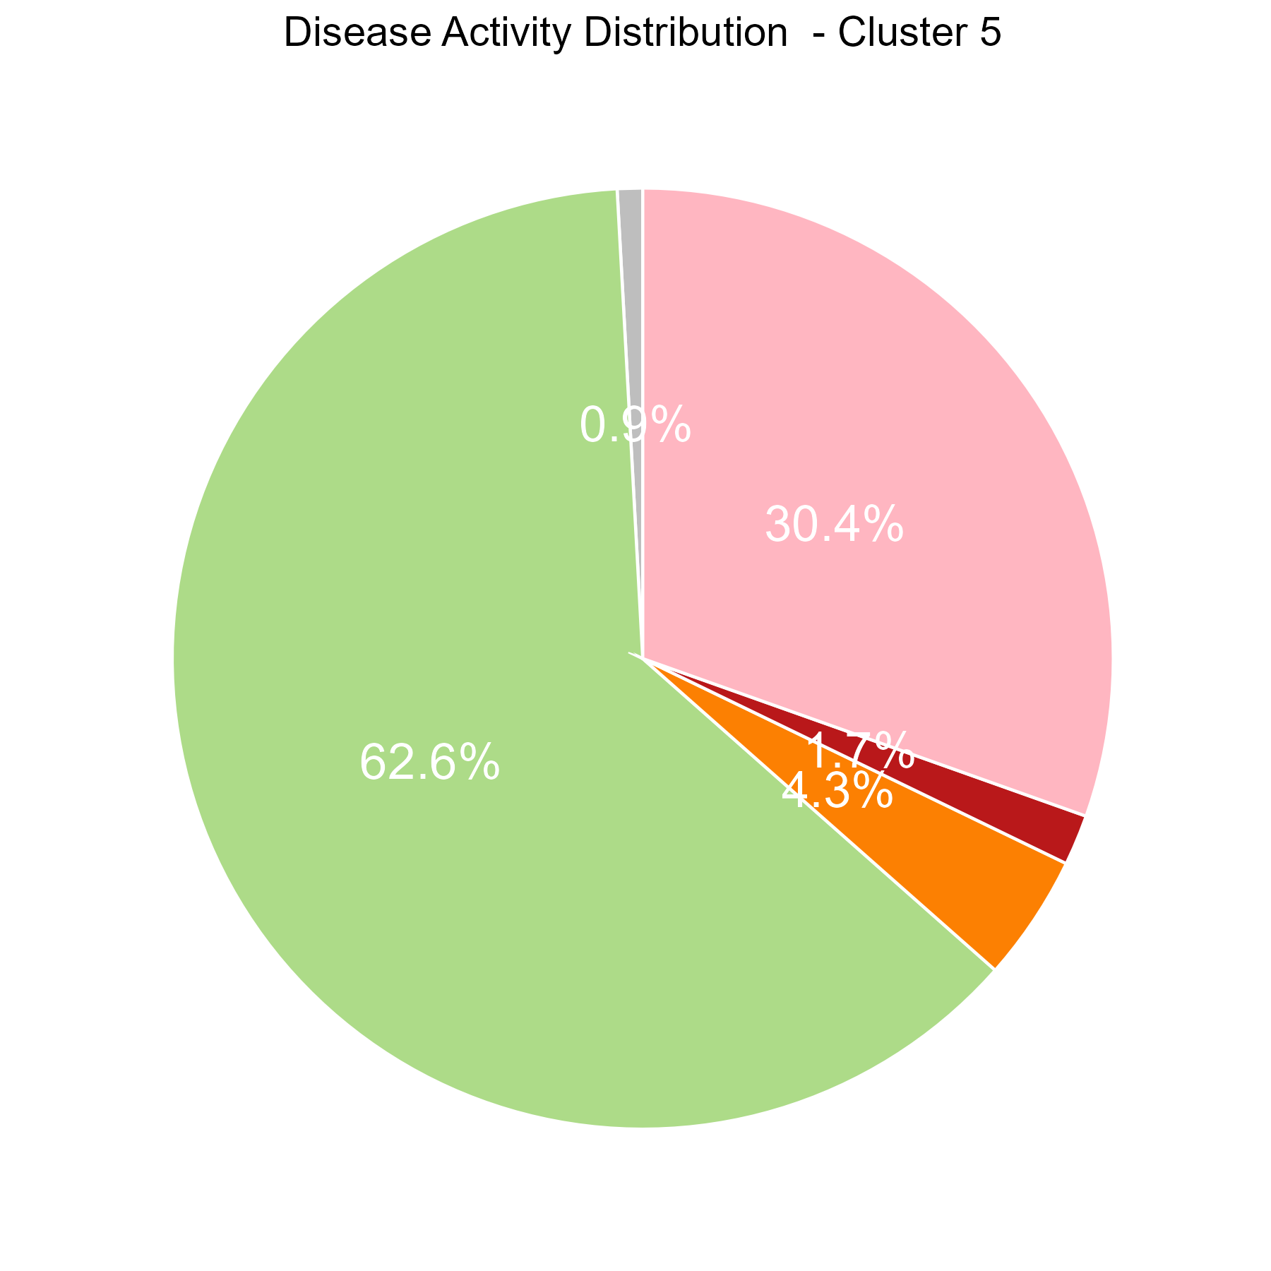
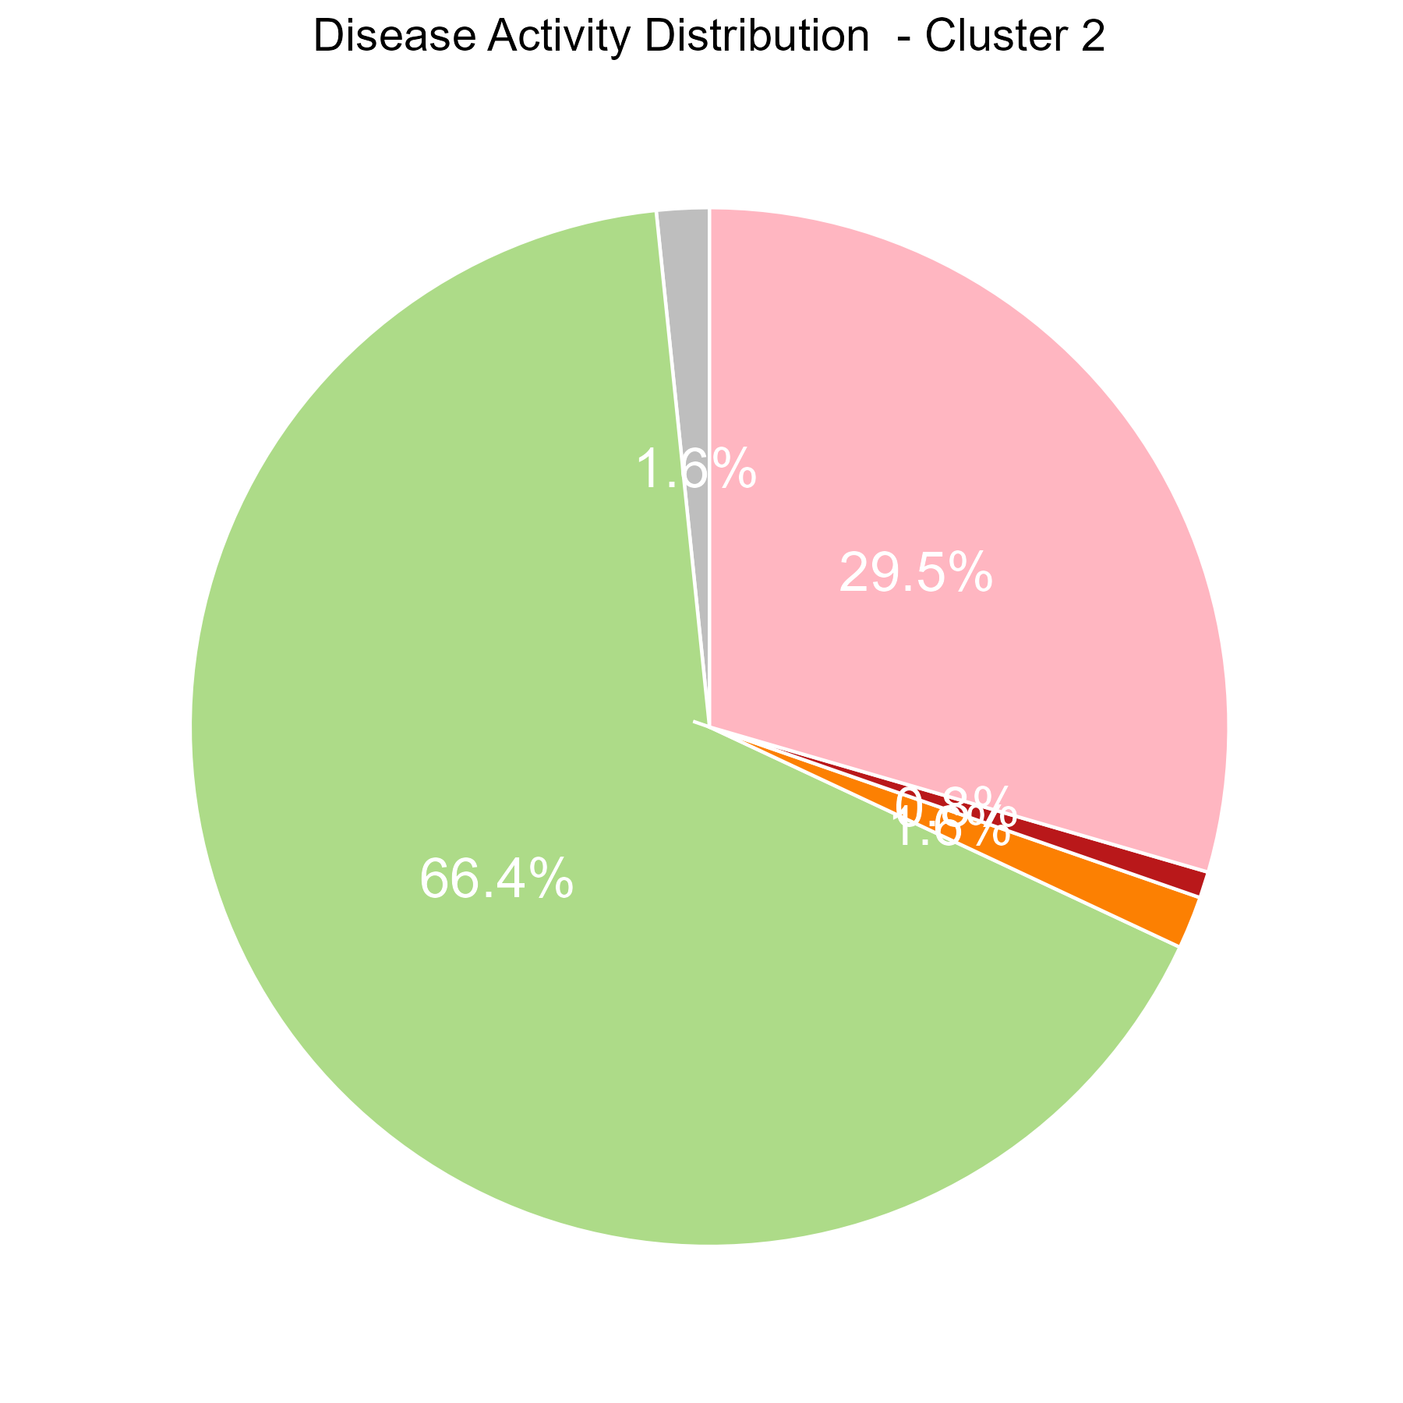
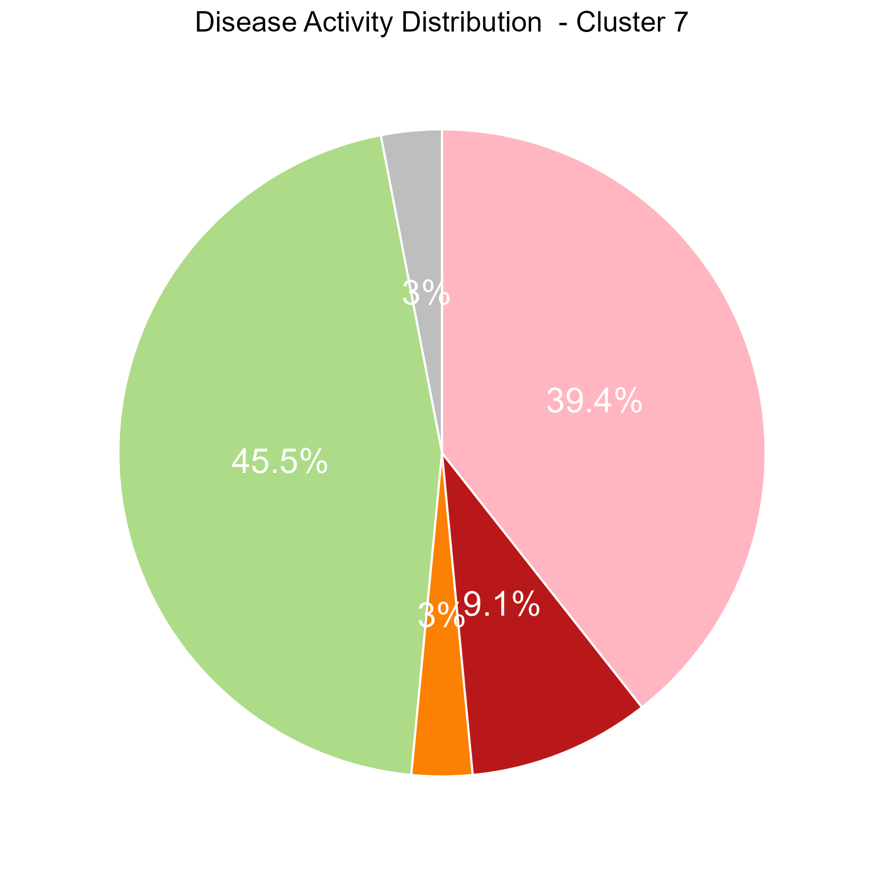
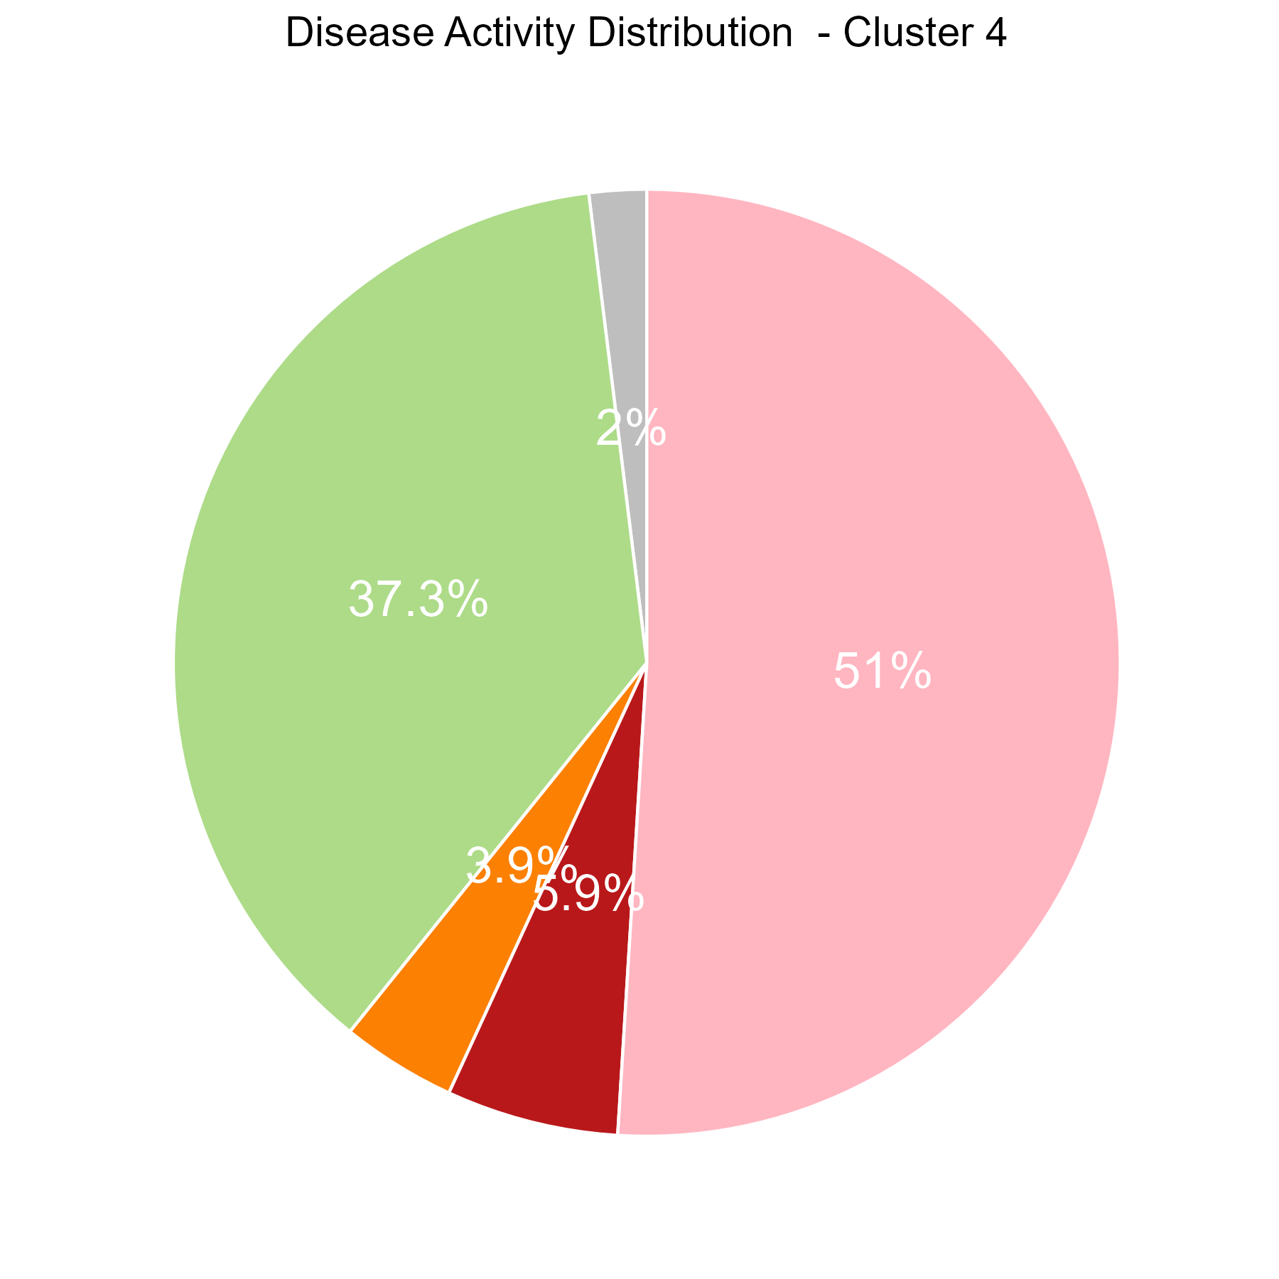
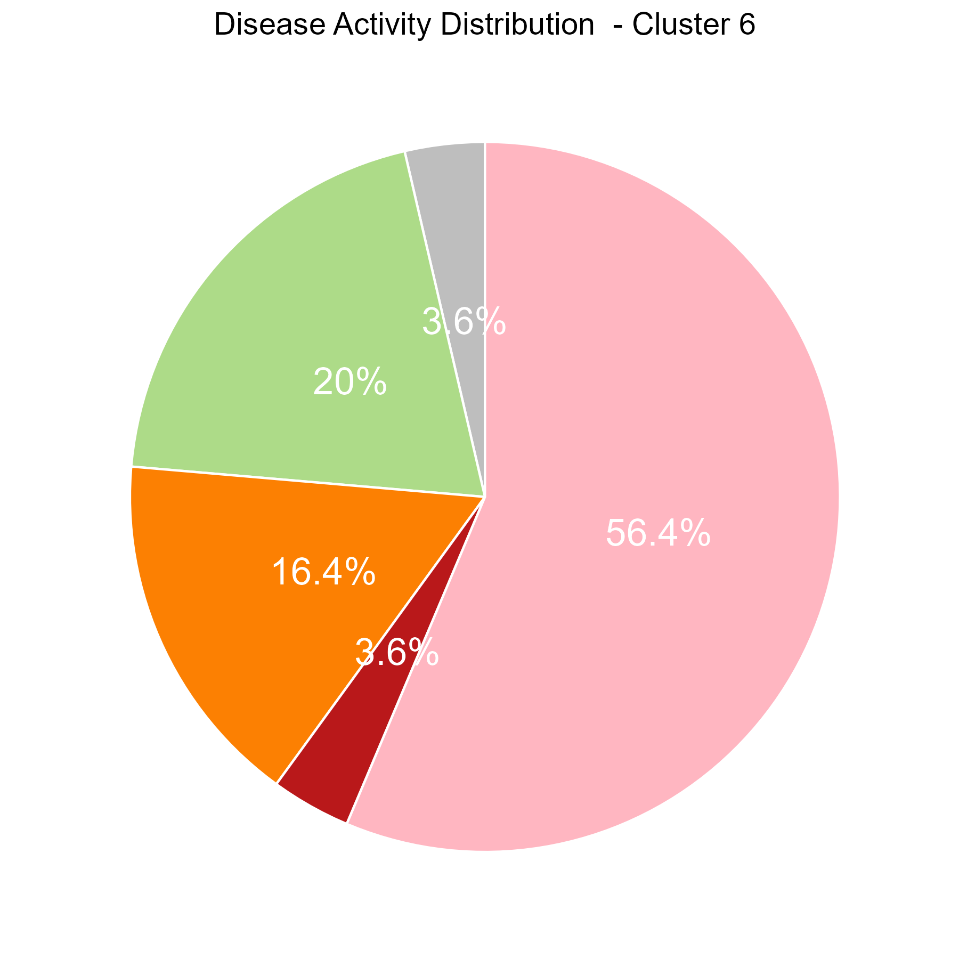
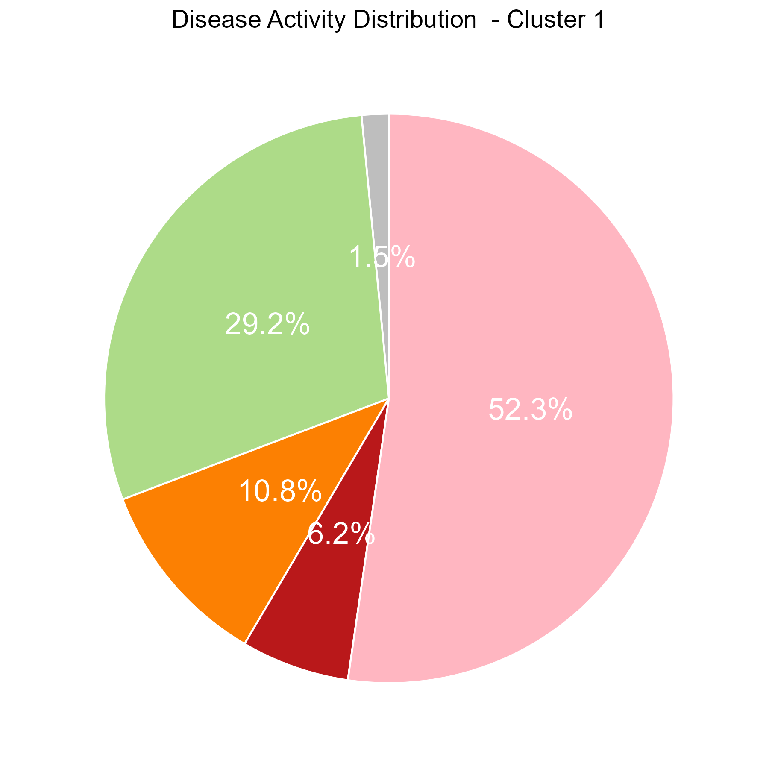
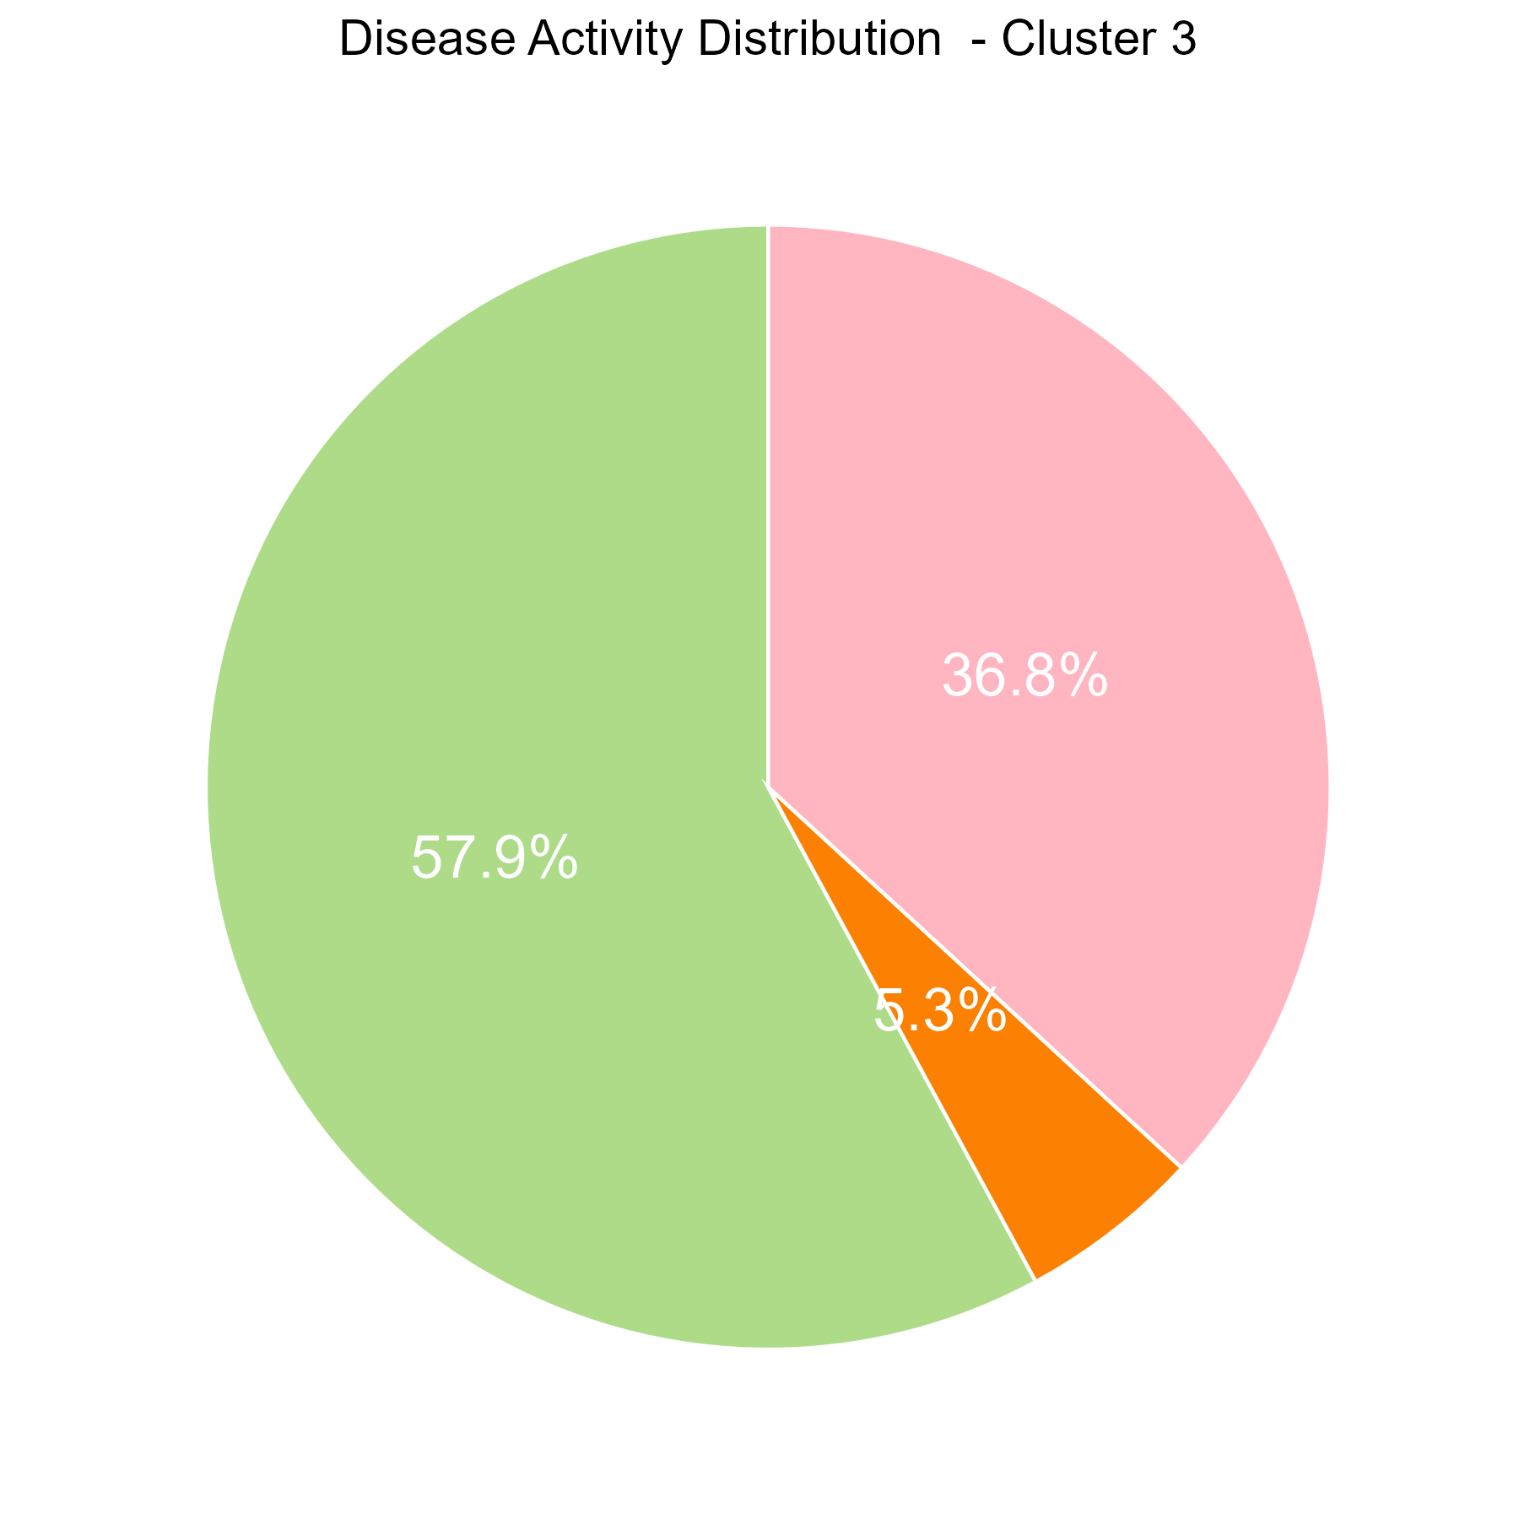
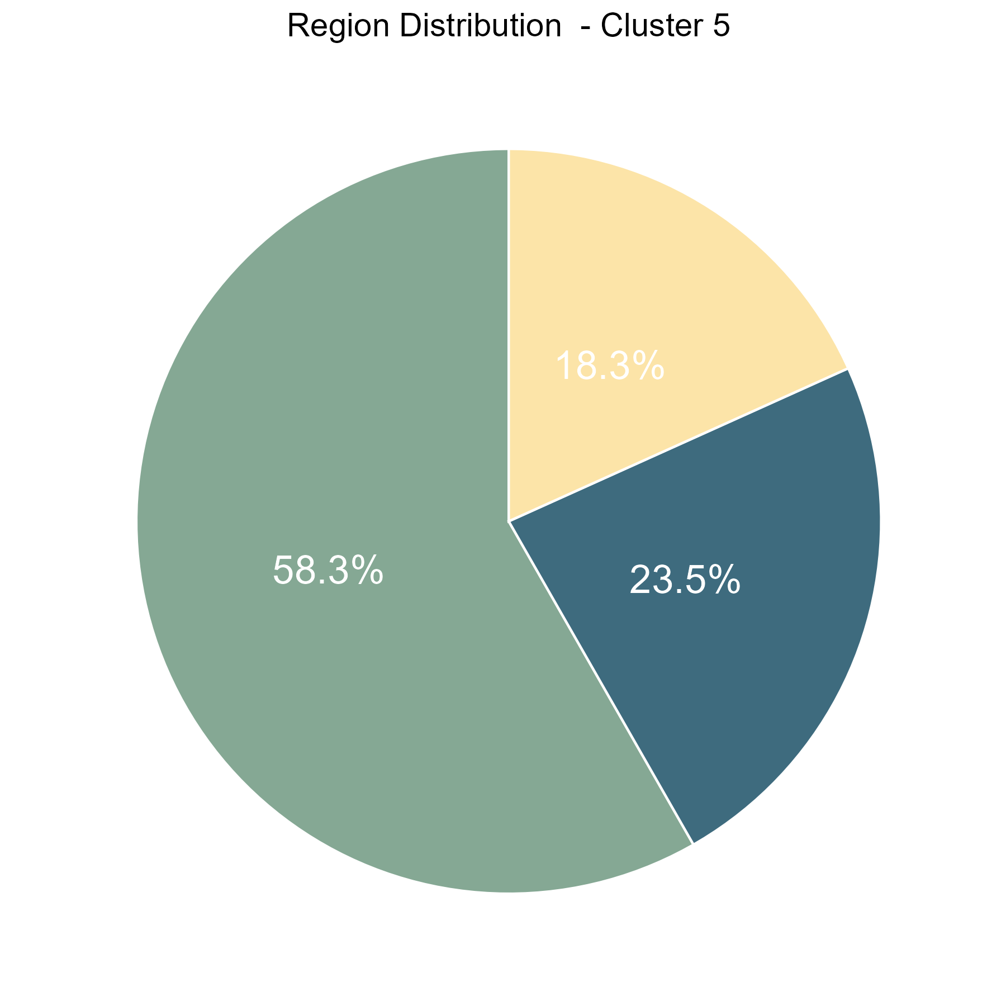
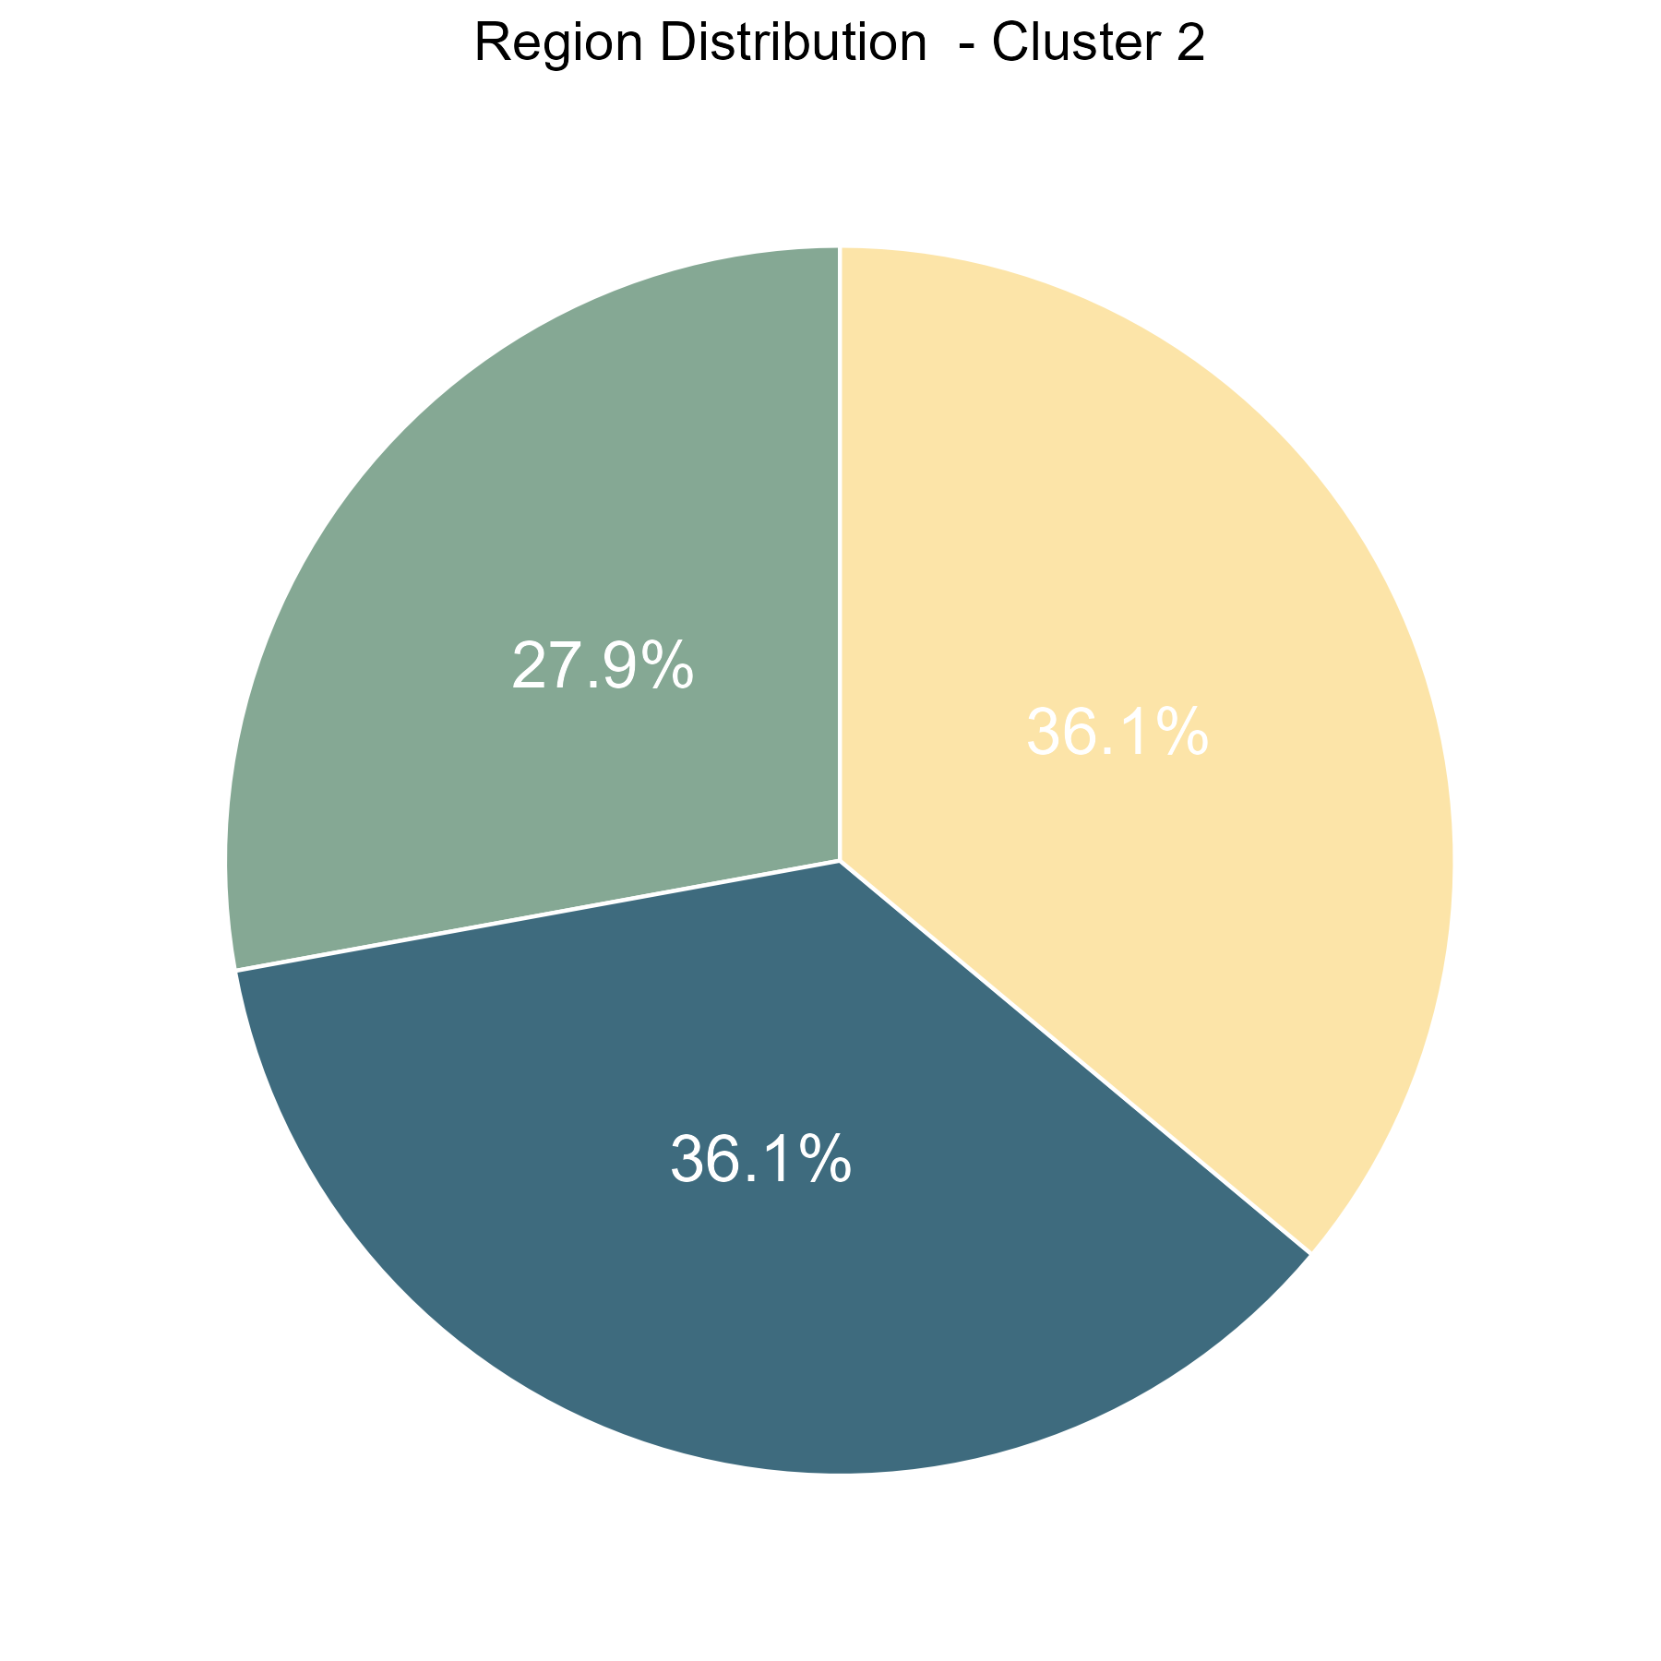
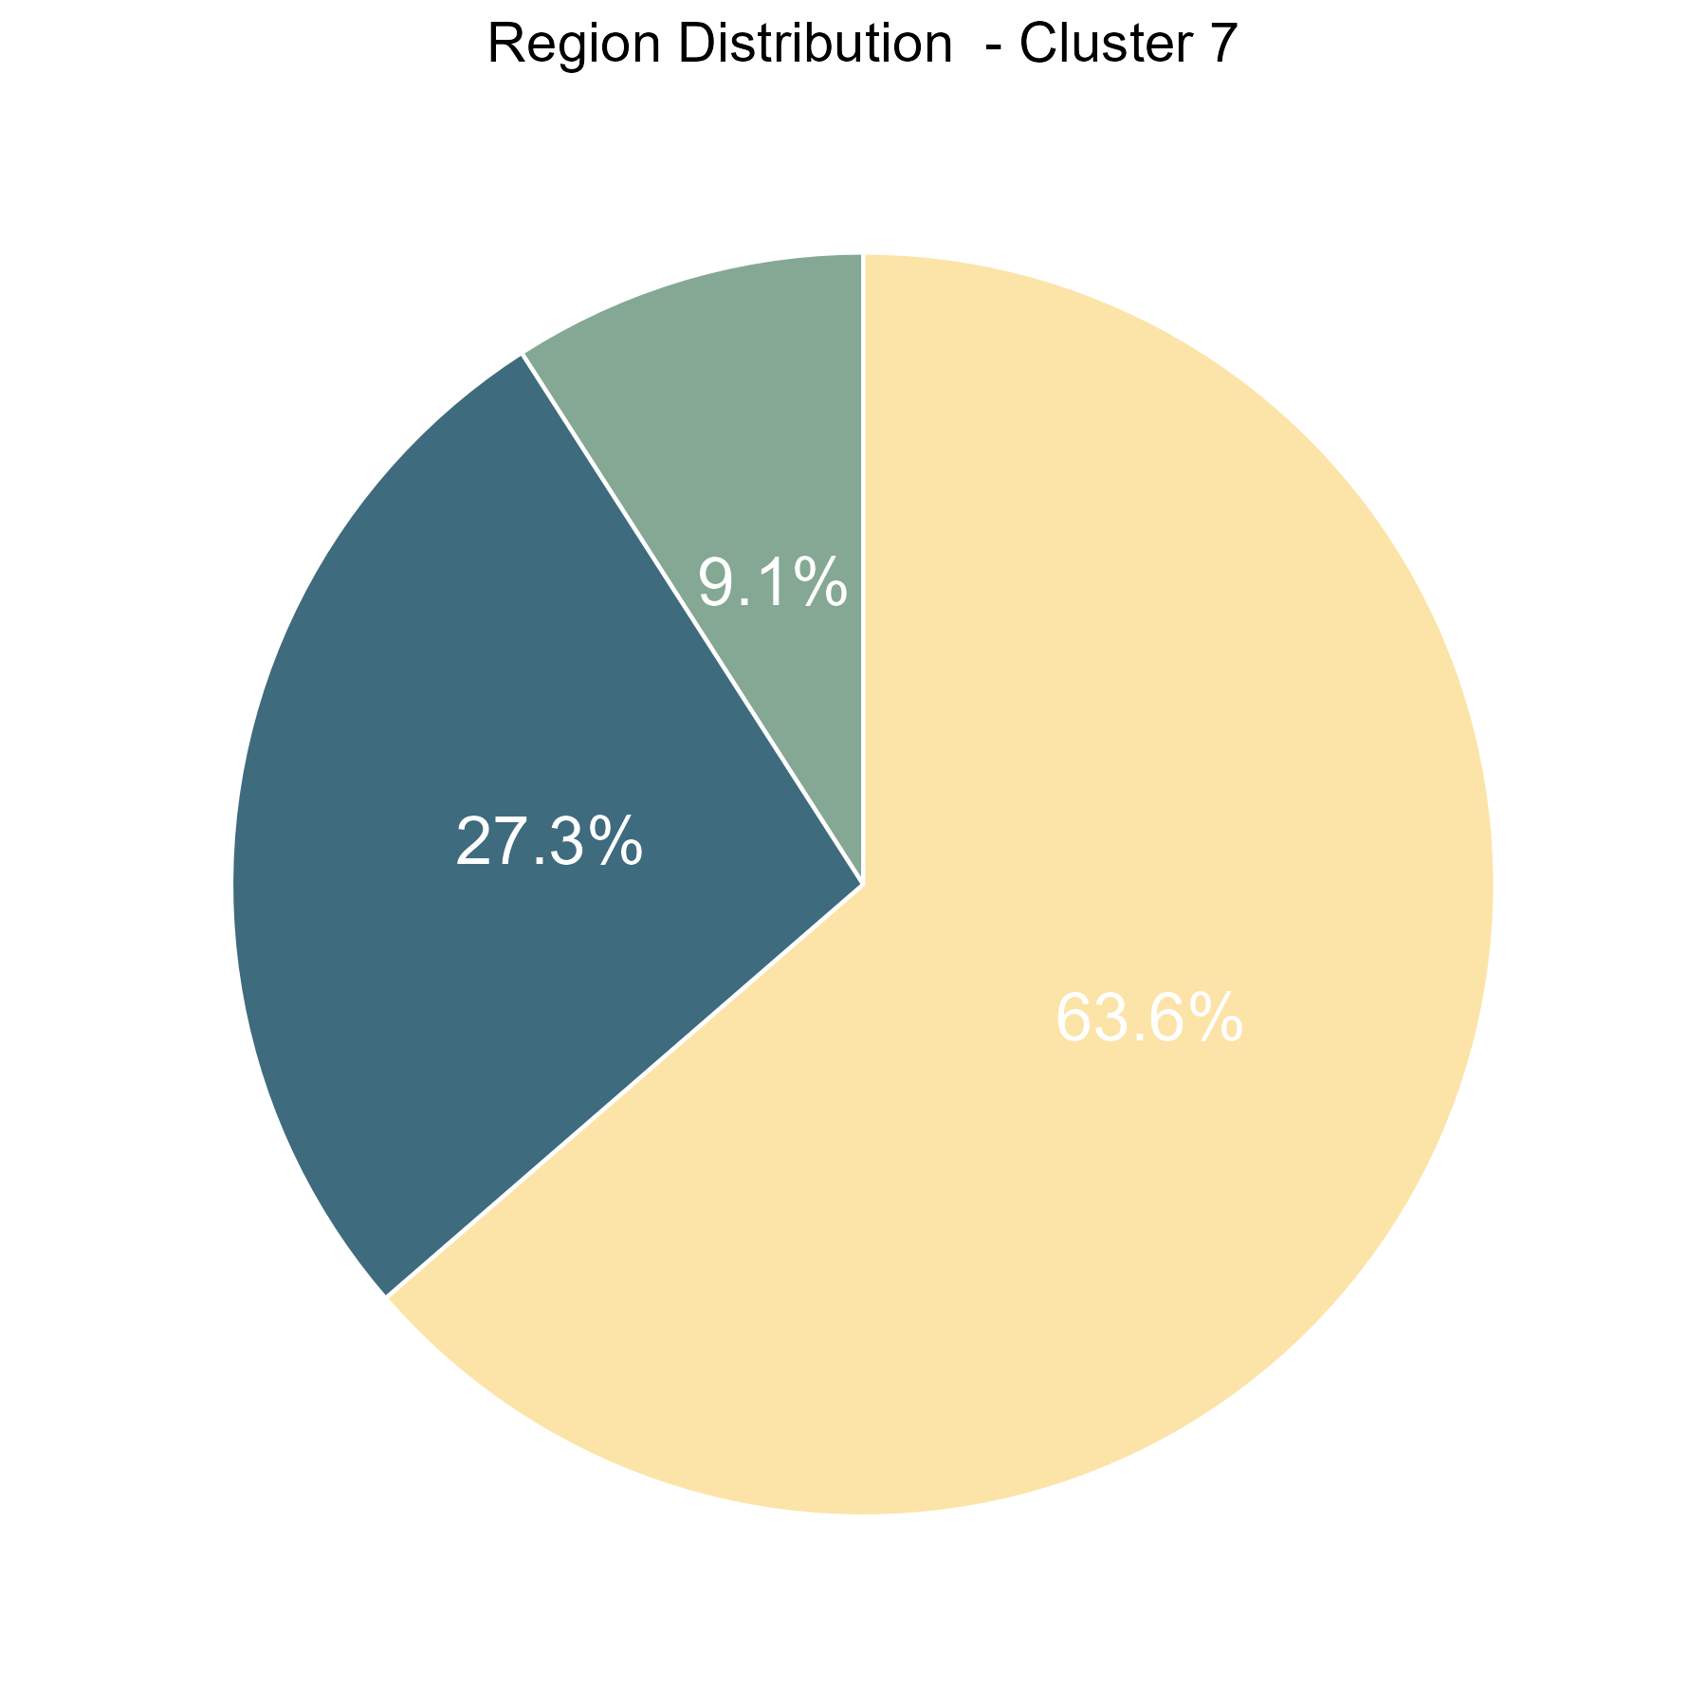
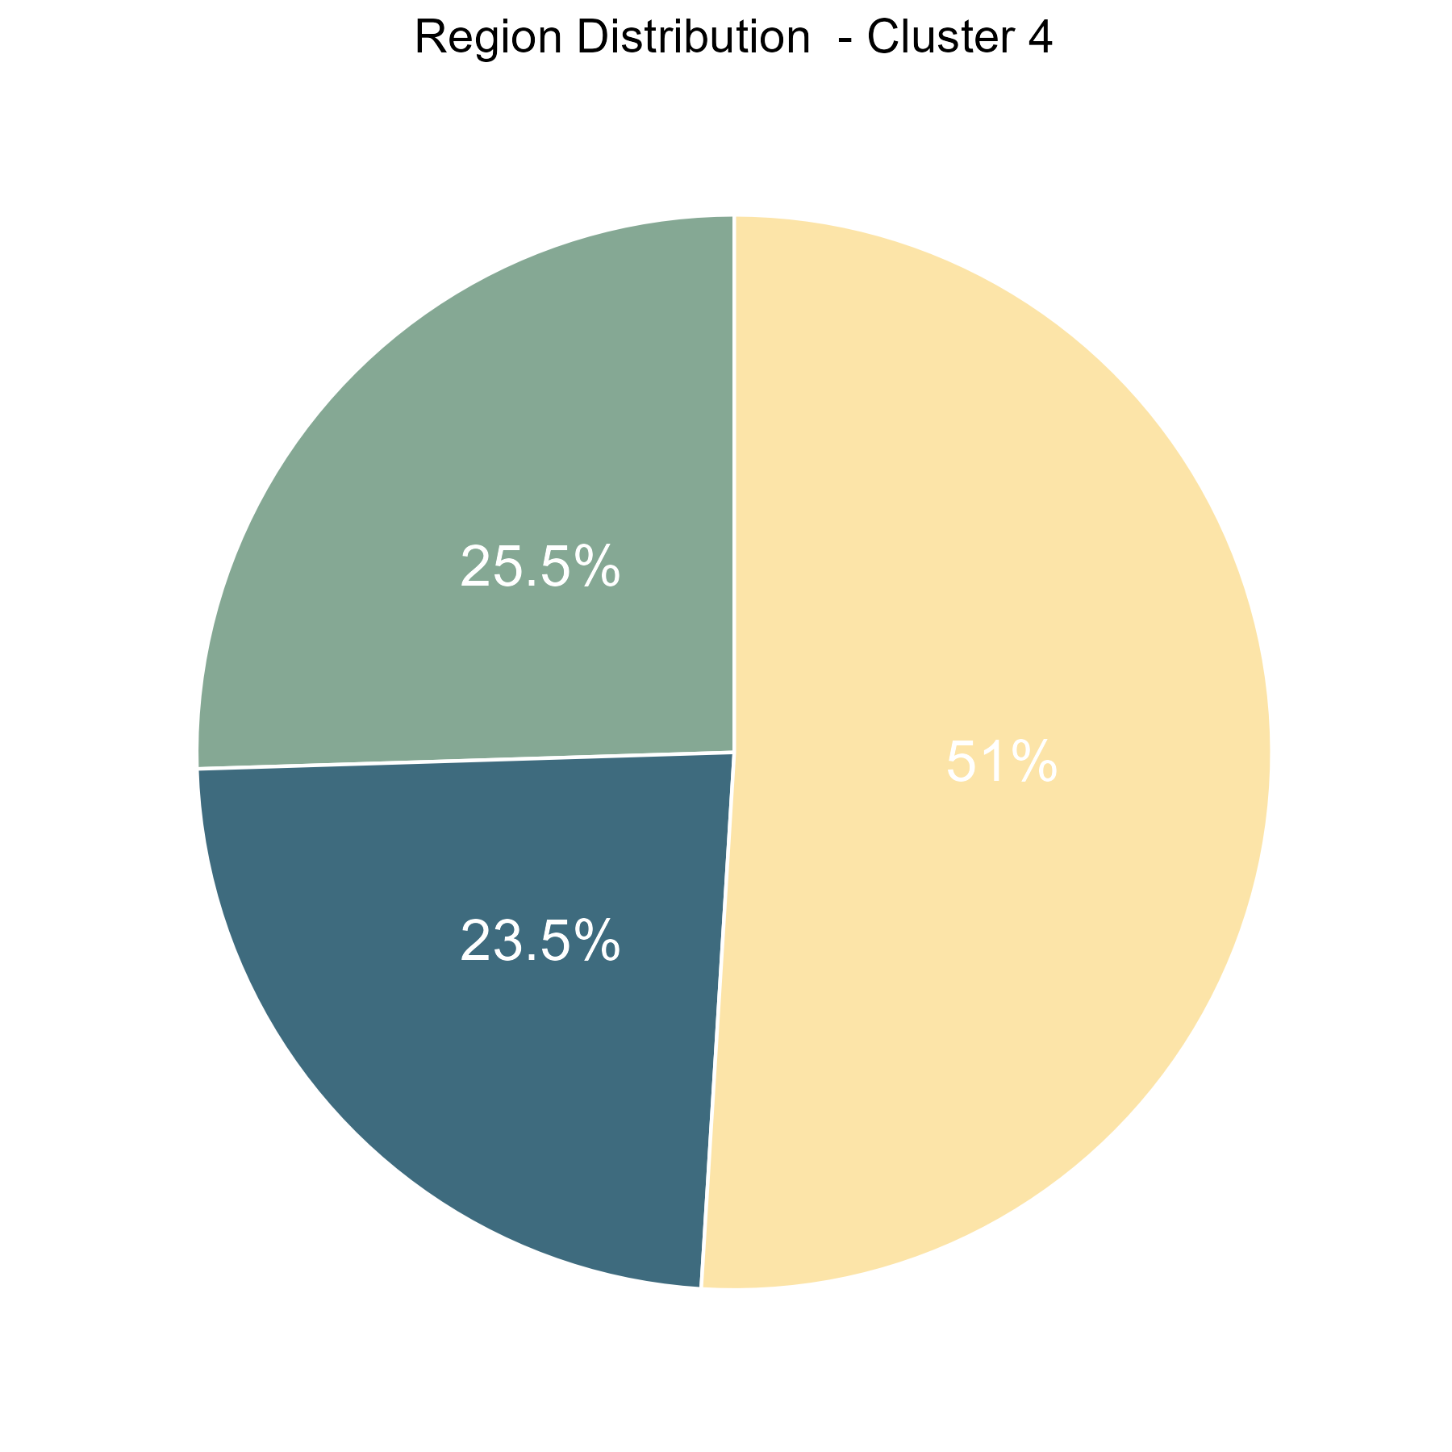
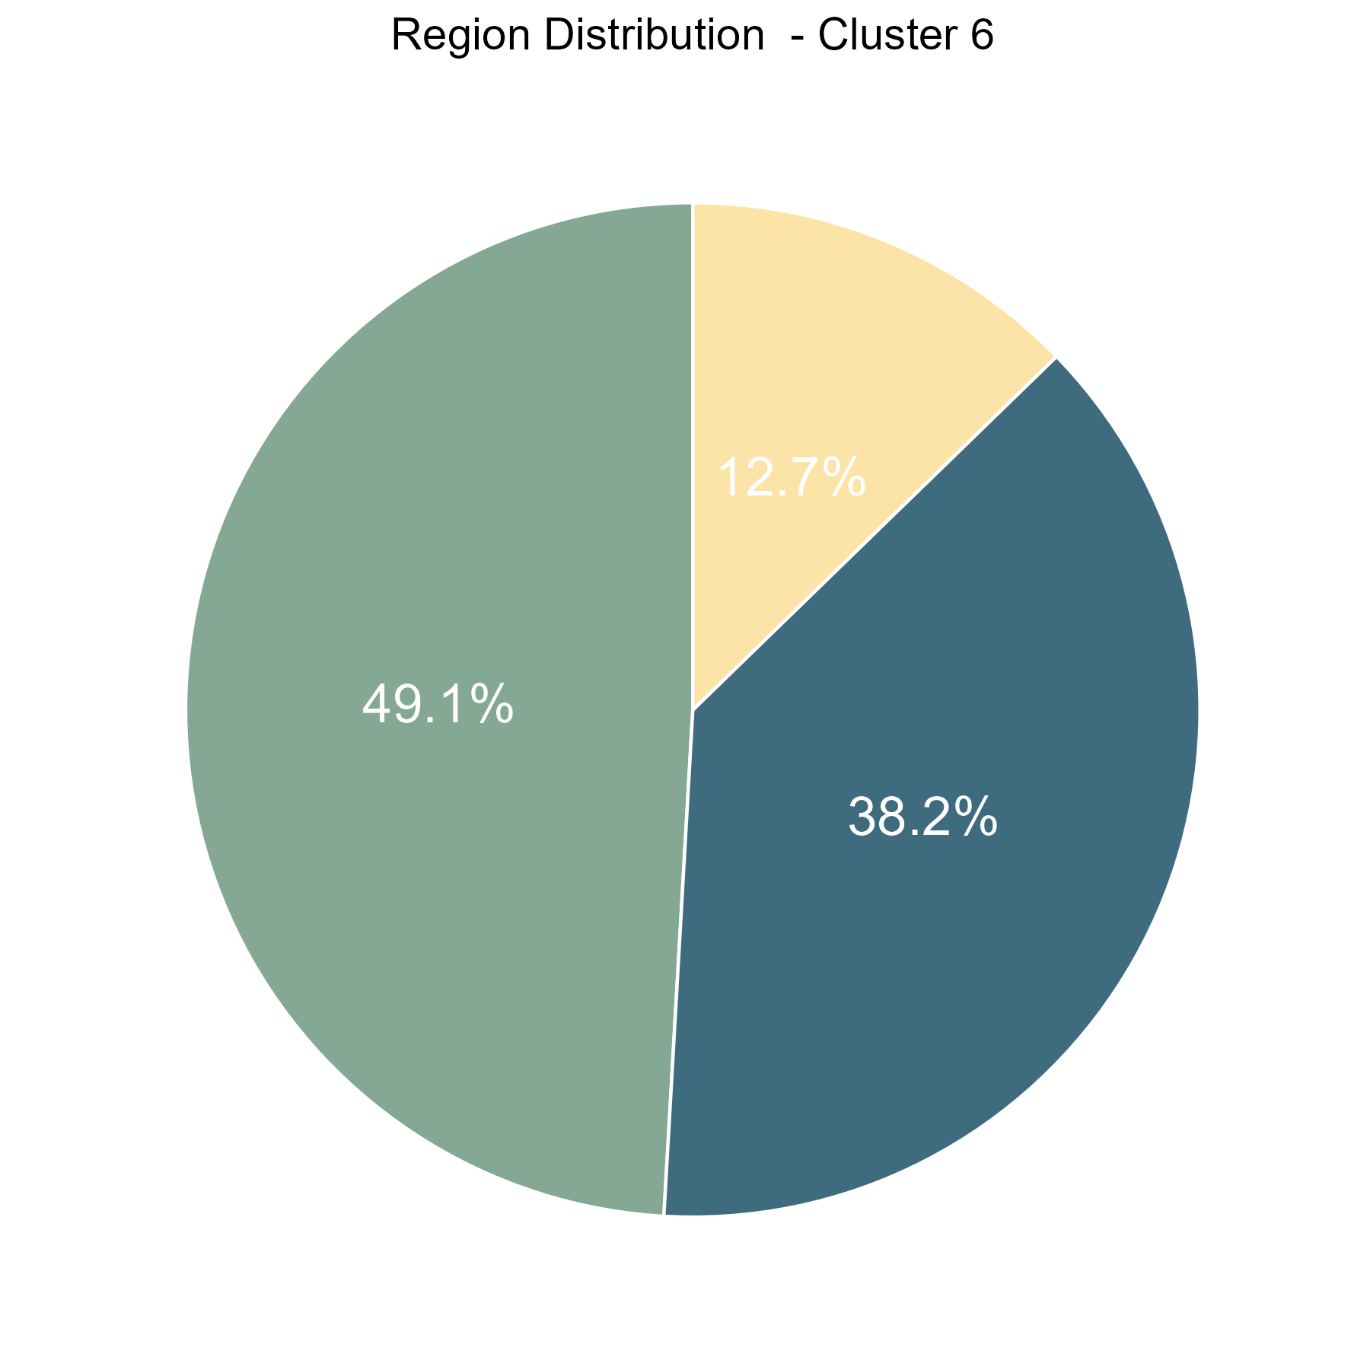
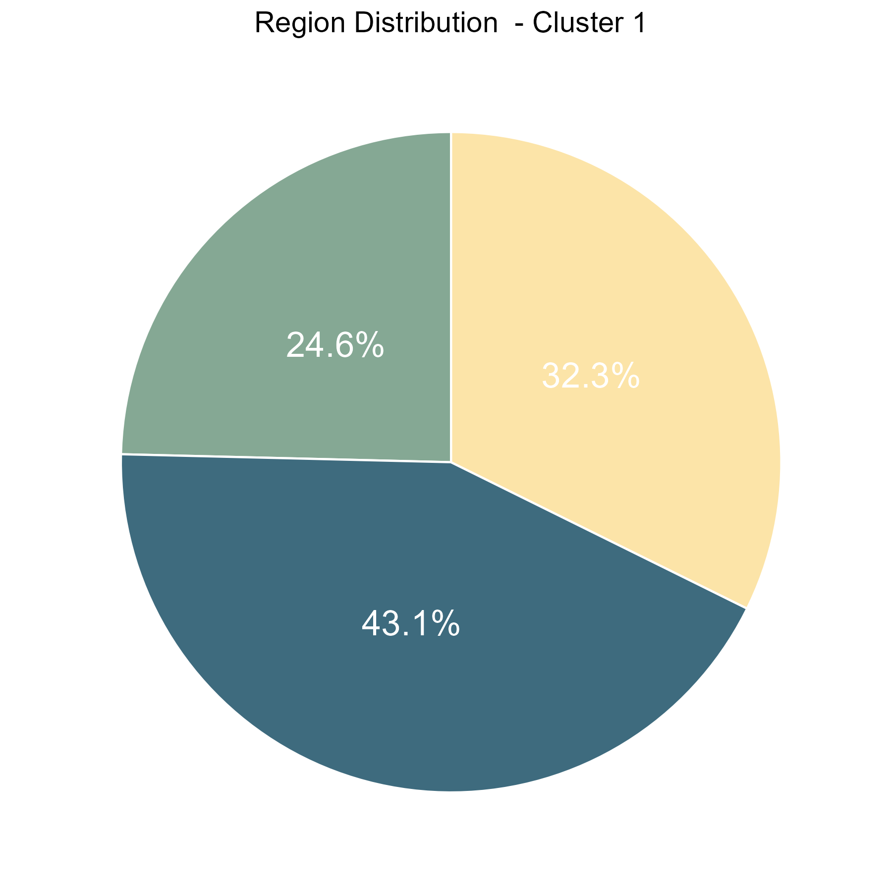
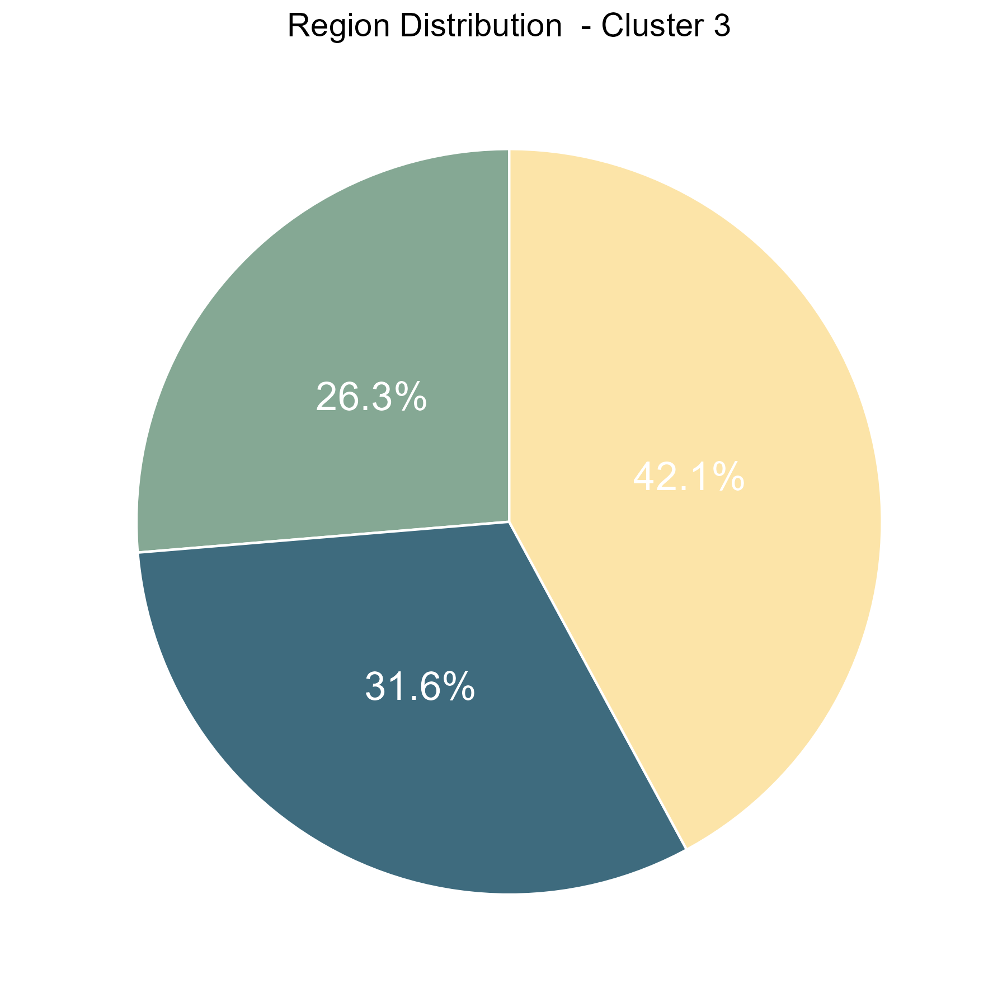
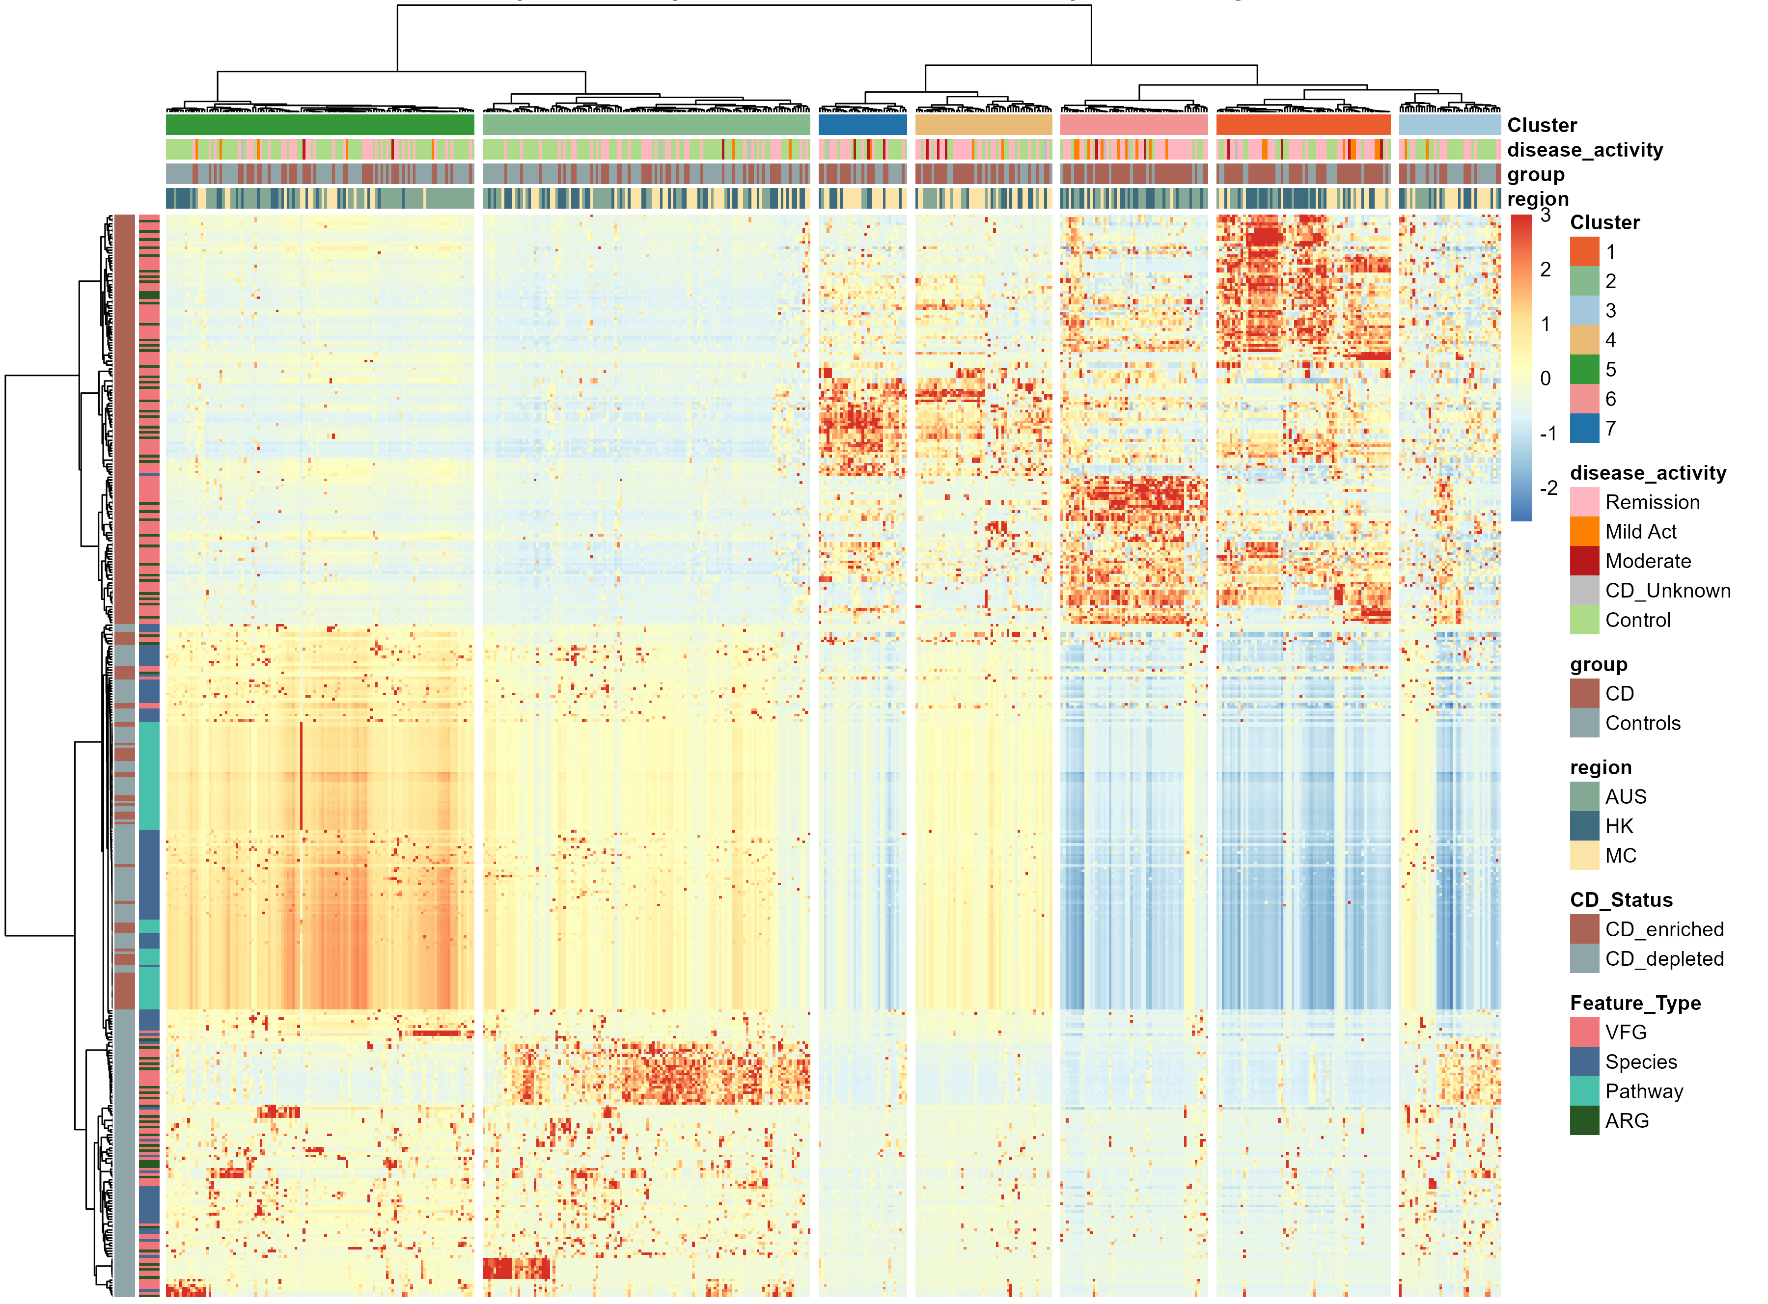
% By disease
% By region
A
B
Based on the differential features, all samples were divided into two clusters (A and B).
Cluster A consisted mainly of controls (65%) and patients with remission of CD, while Cluster B was predominantly comprised of patients with CD (64%), with 14% of them being mild to moderate cases.
5
2
7
4
6
1
3
Notes:
1 2 3 4 5 6 7
65 122 38 51 115 55 33
Cluster A中84个 CD一共237 （35%）
Cluster A中10个 mild moderate 一共237（4%）
Cluster B中156个 CD一共242 （64%）
Cluster B中33个 mild moderate 一共242（14%）
根据差异的特征，所有sample被分成了两个cluster（A和B）。
ClusterA更多是control（65%）和remission的CD病人
ClusterB更多是CD病人（64%）,其中mild to moderate的病人有14%

Slide 25
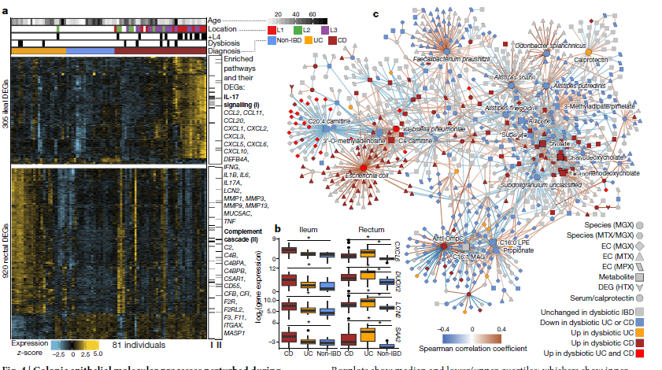
Plan
Correlation network of features within clusters
Example:

Slide 26
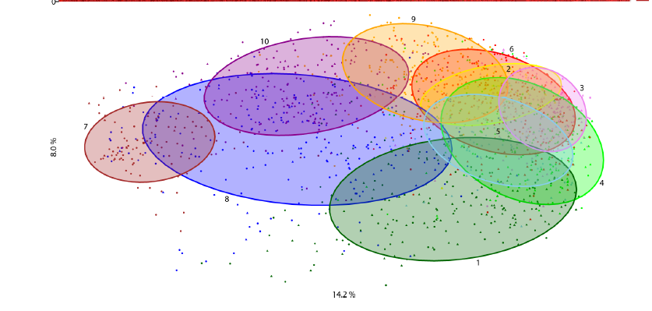
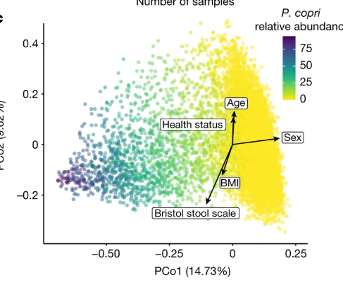
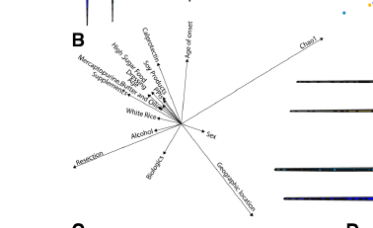
REGION
DISEASE
AGE
SEX
BMI
CDAI
MEDICATION
DIET
Mesalazine(5ASA)
Steriods
Immunosuppressant
Biologics
Notes:
Environmental factors shaping the gut microbiome in a Dutch population

Slide 27
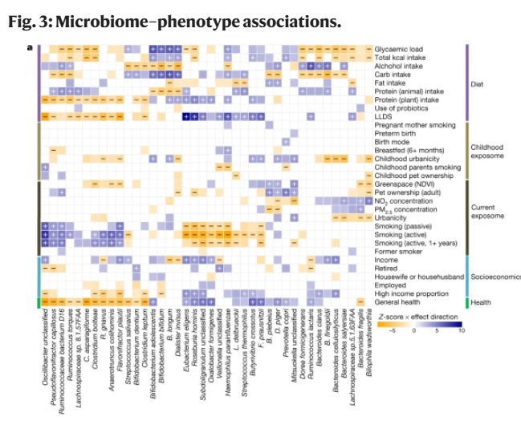
Plan
Correlation between metadata and features within clusters
Example:

Slide 28
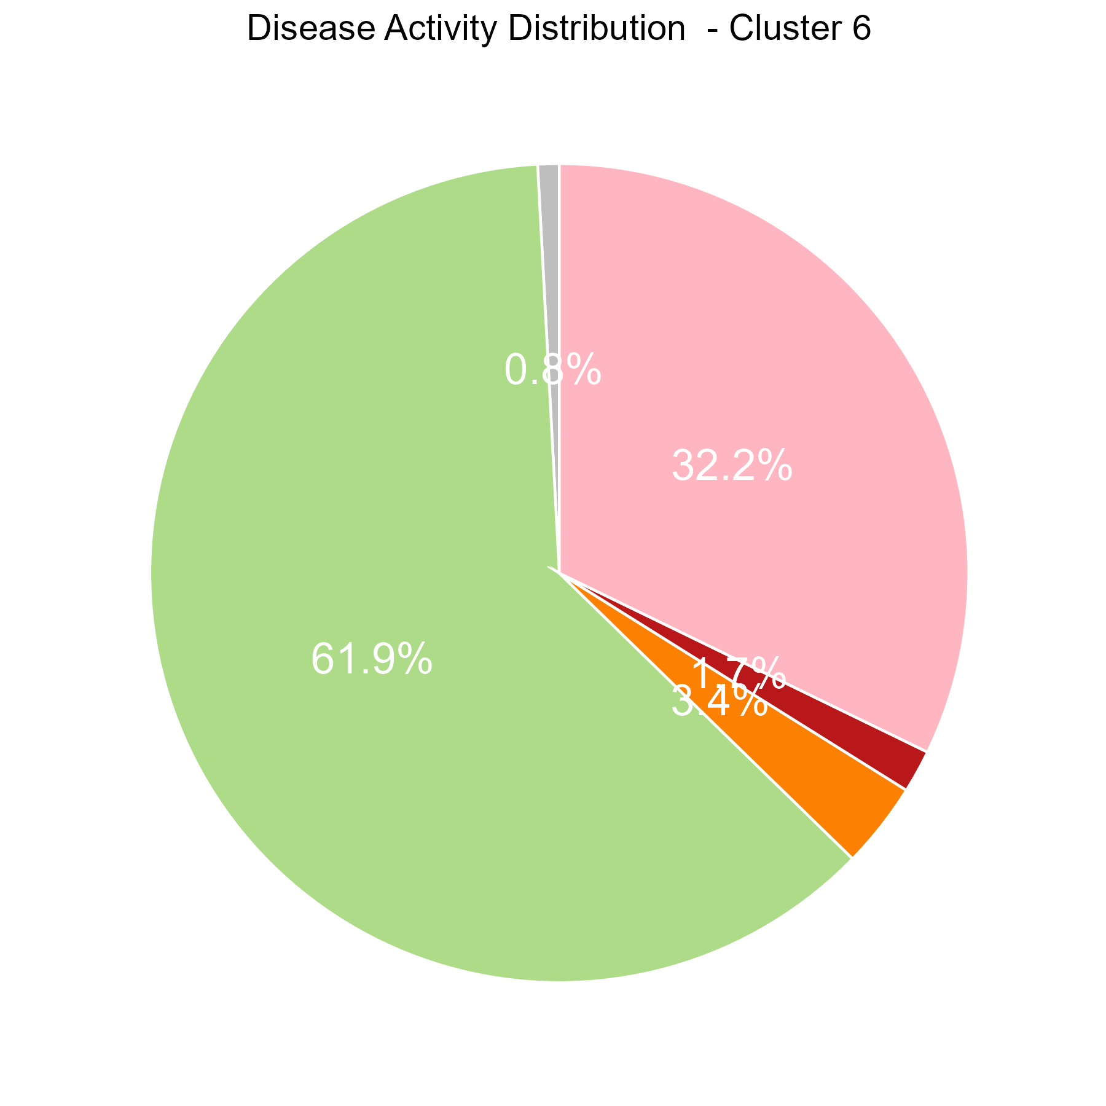
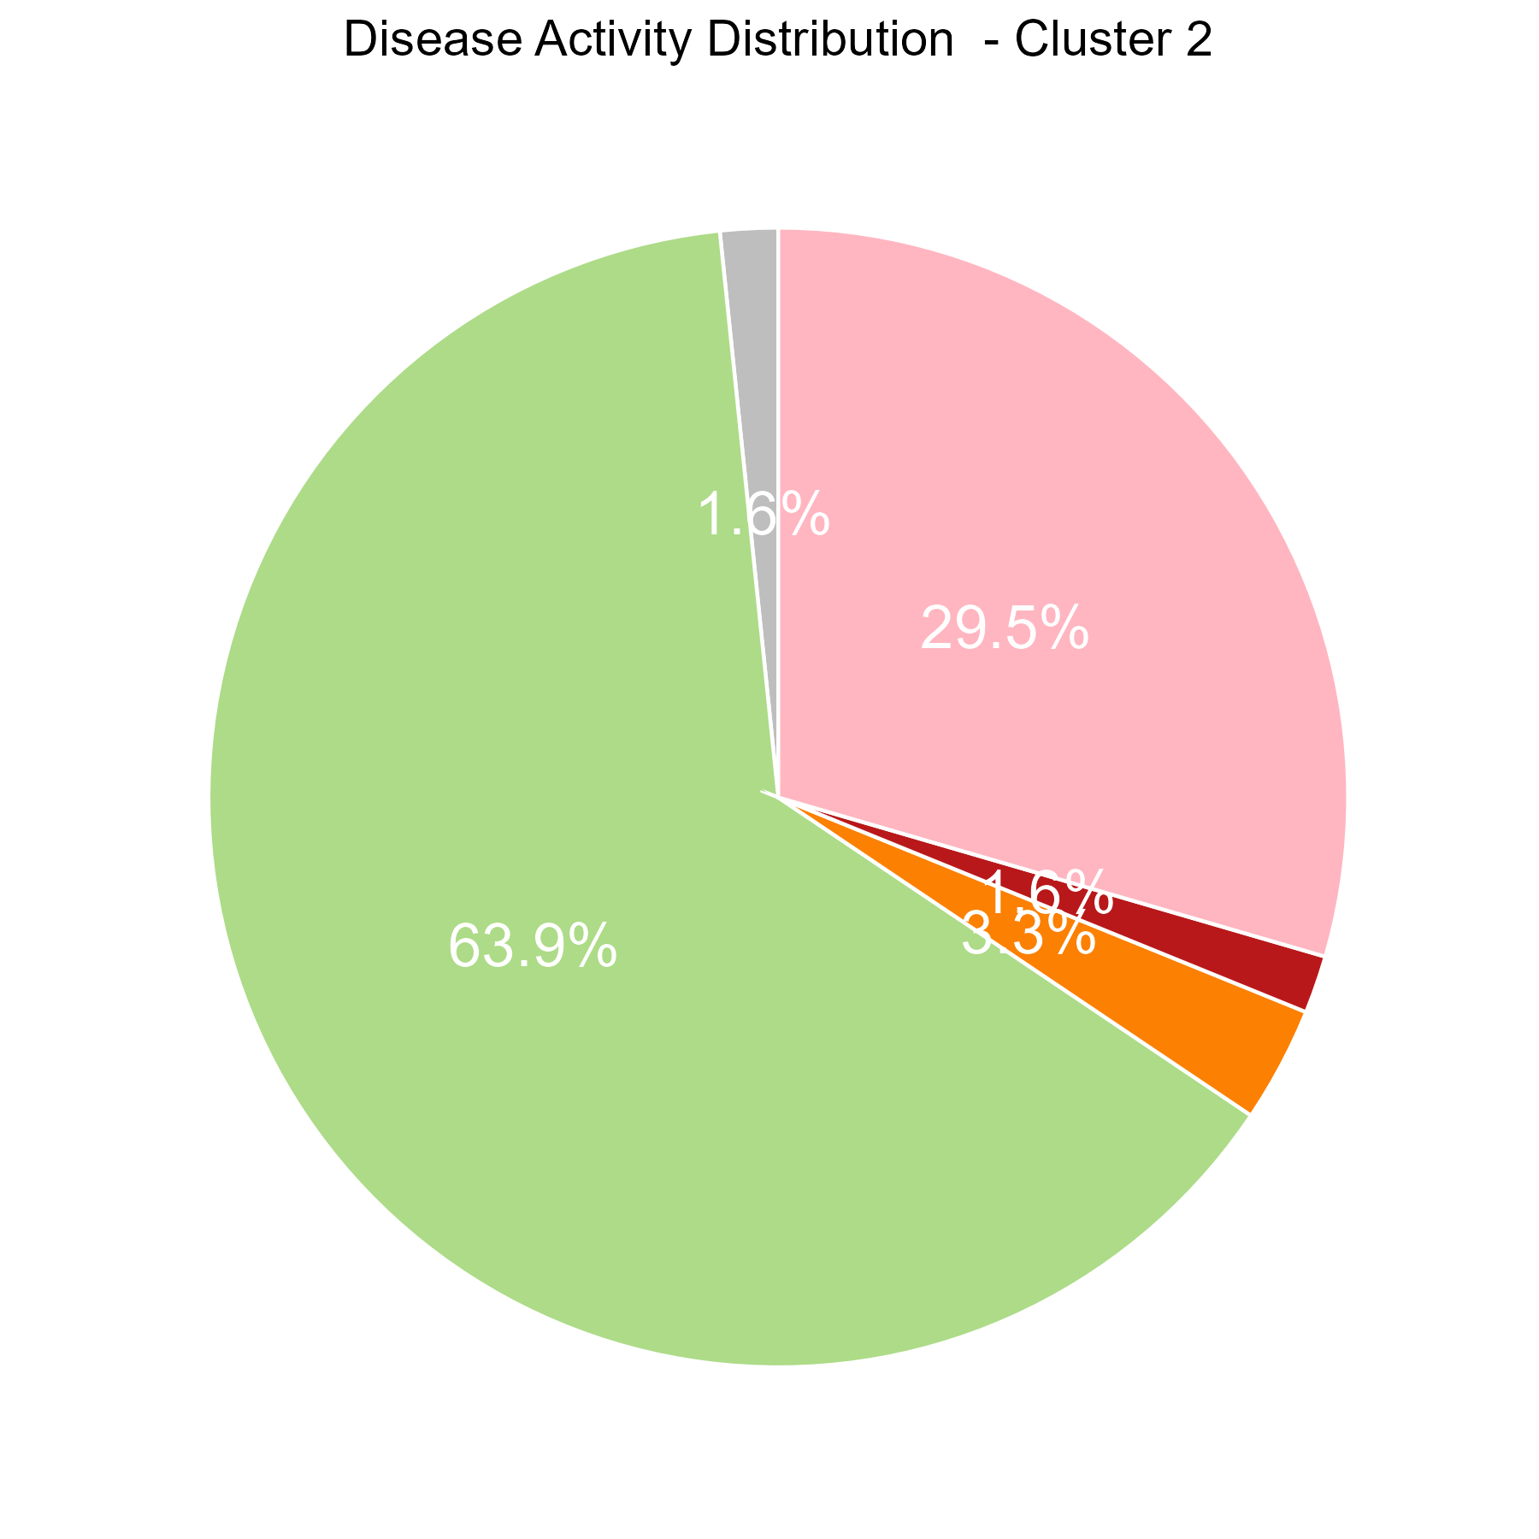
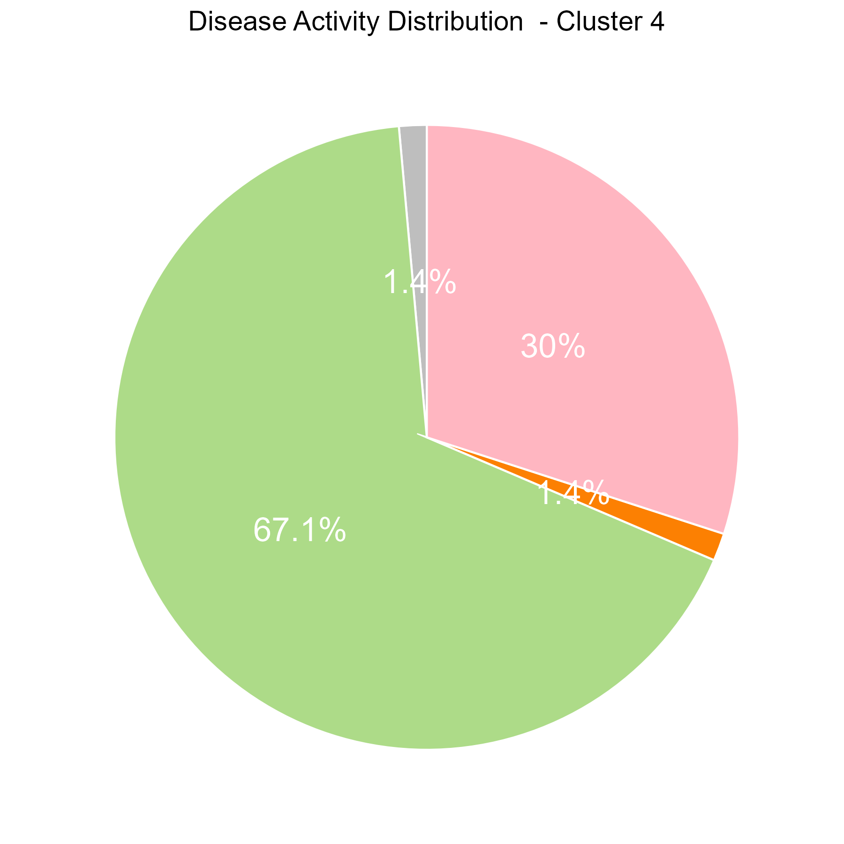
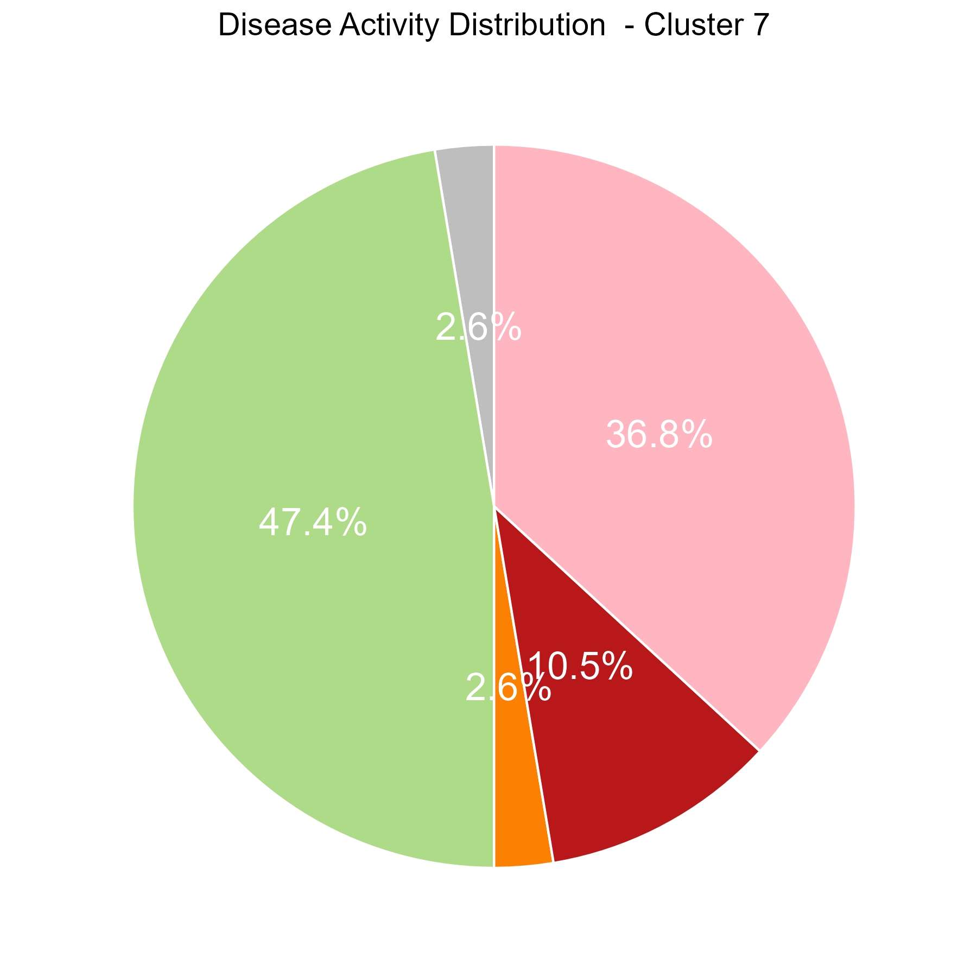











% By disease
% By region
A
B
6
2
4
7
5
3
1
Notes:
1 2 3 4 5 6 7
85 61 67 70 40 118 38
Cluster A中90个 CD一共249（36%）
Cluster A中10个 mild moderate 一共249（4%）
Cluster B中150个 CD一共230 （65%）
Cluster B中33个 mild moderate 一共230 （14%）

